Slide 1
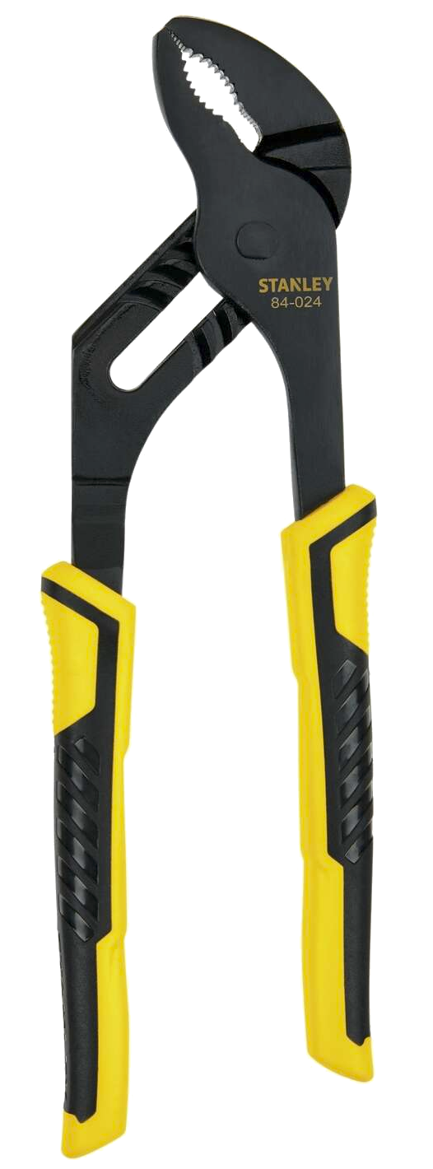
Plier Jaw Grip
Measurement and Wear Rig
Team SBD-P23
Tessa Erickson, Sasha Khidekel,
Kelsey Neff, Katharine Priu

Slide 2
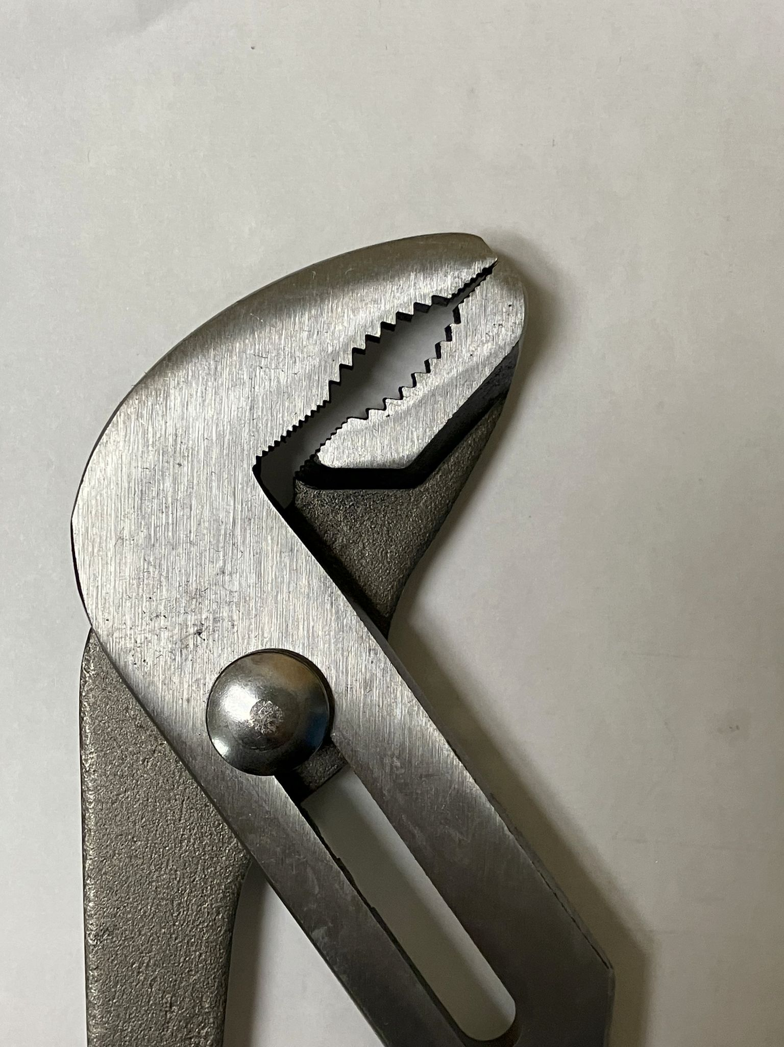
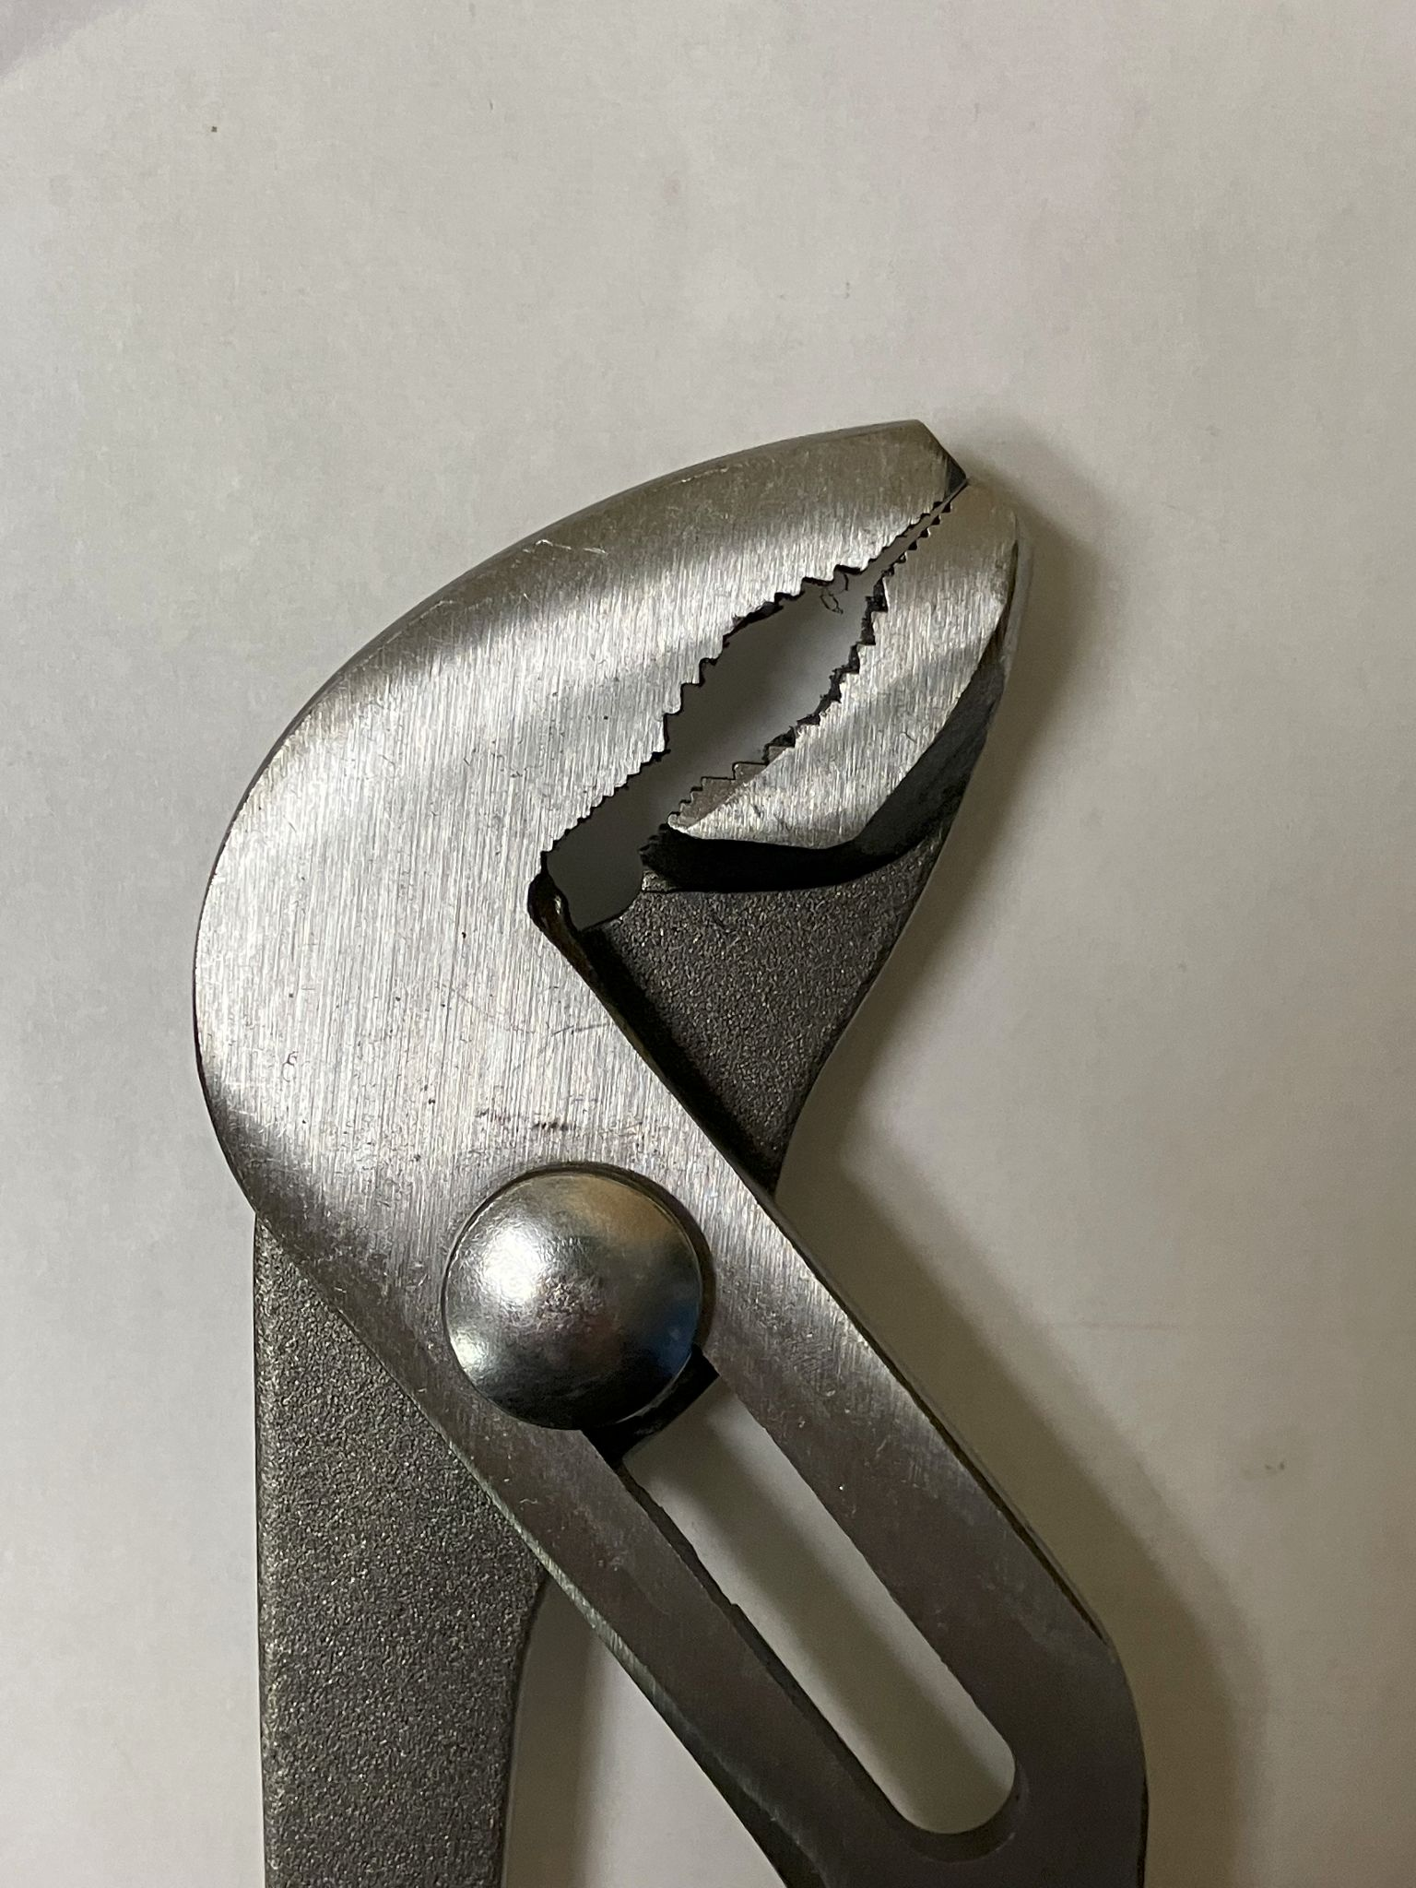
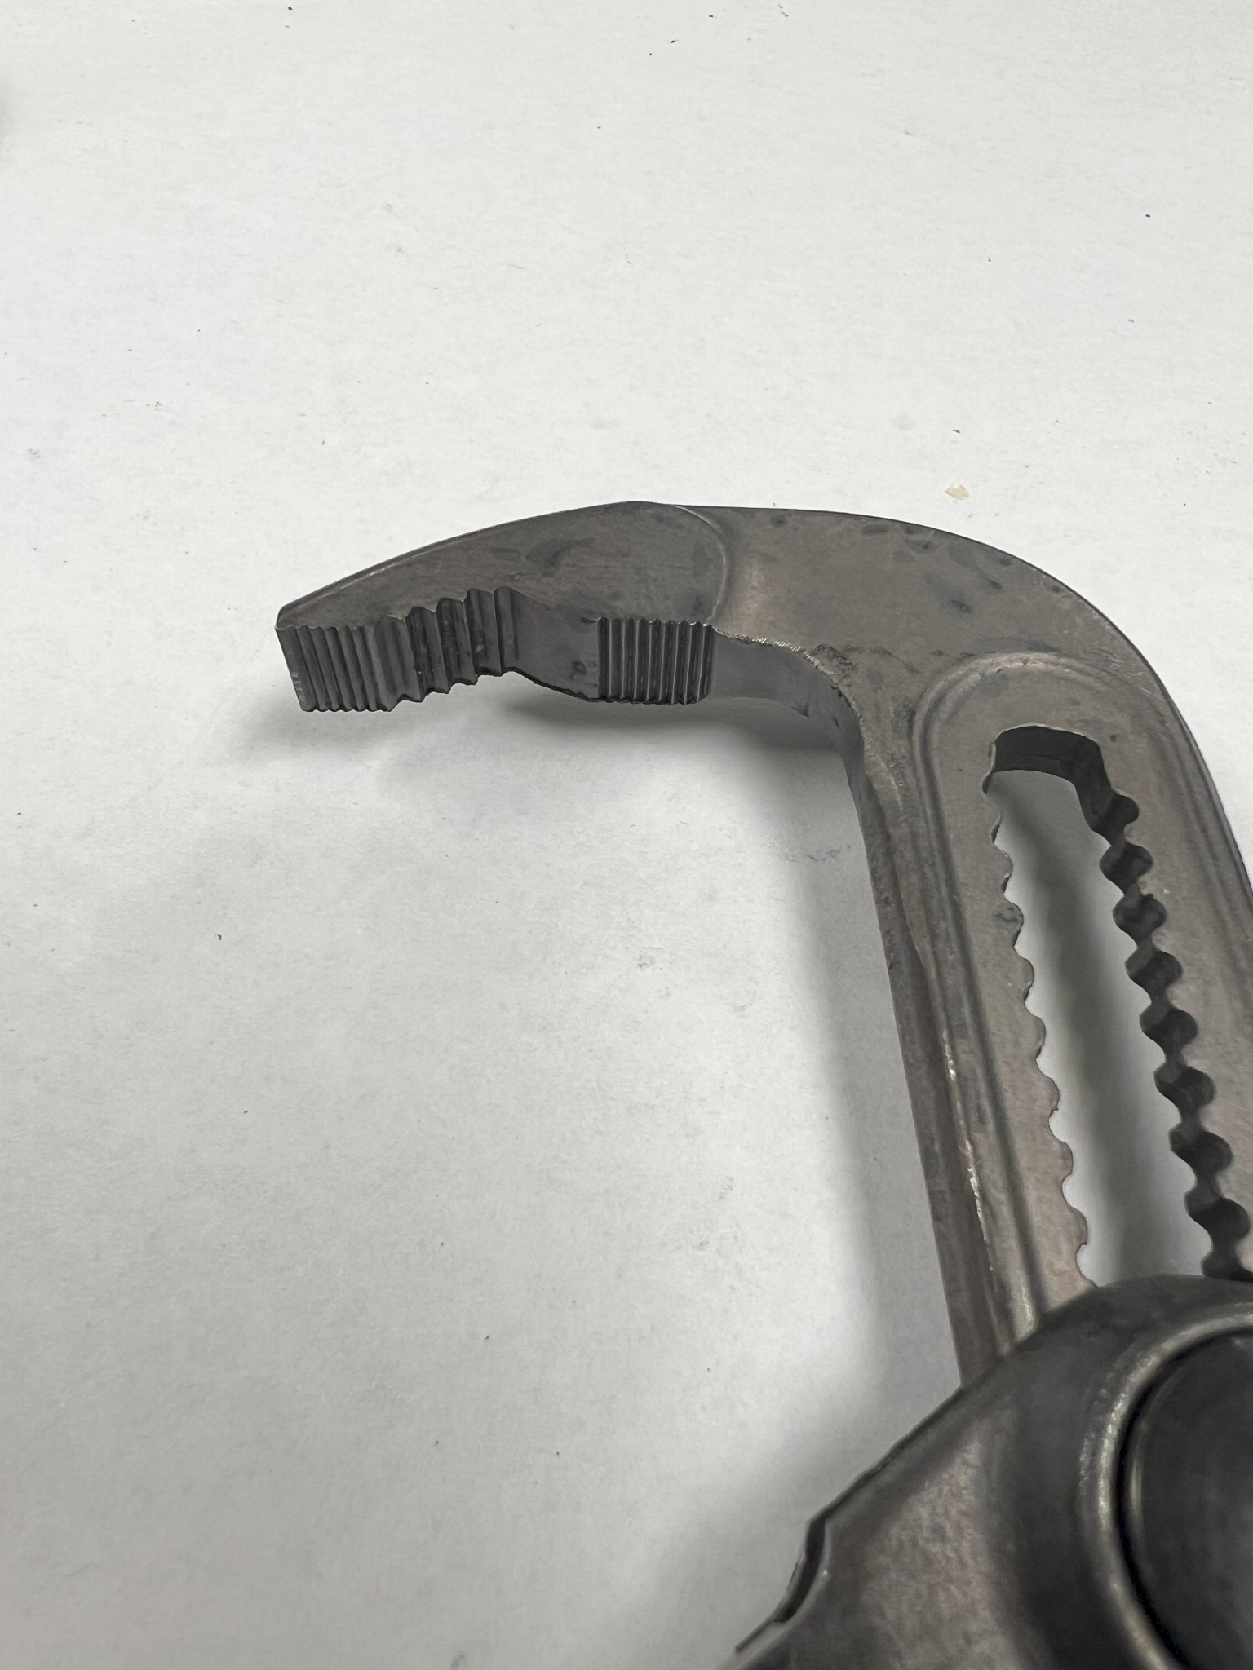
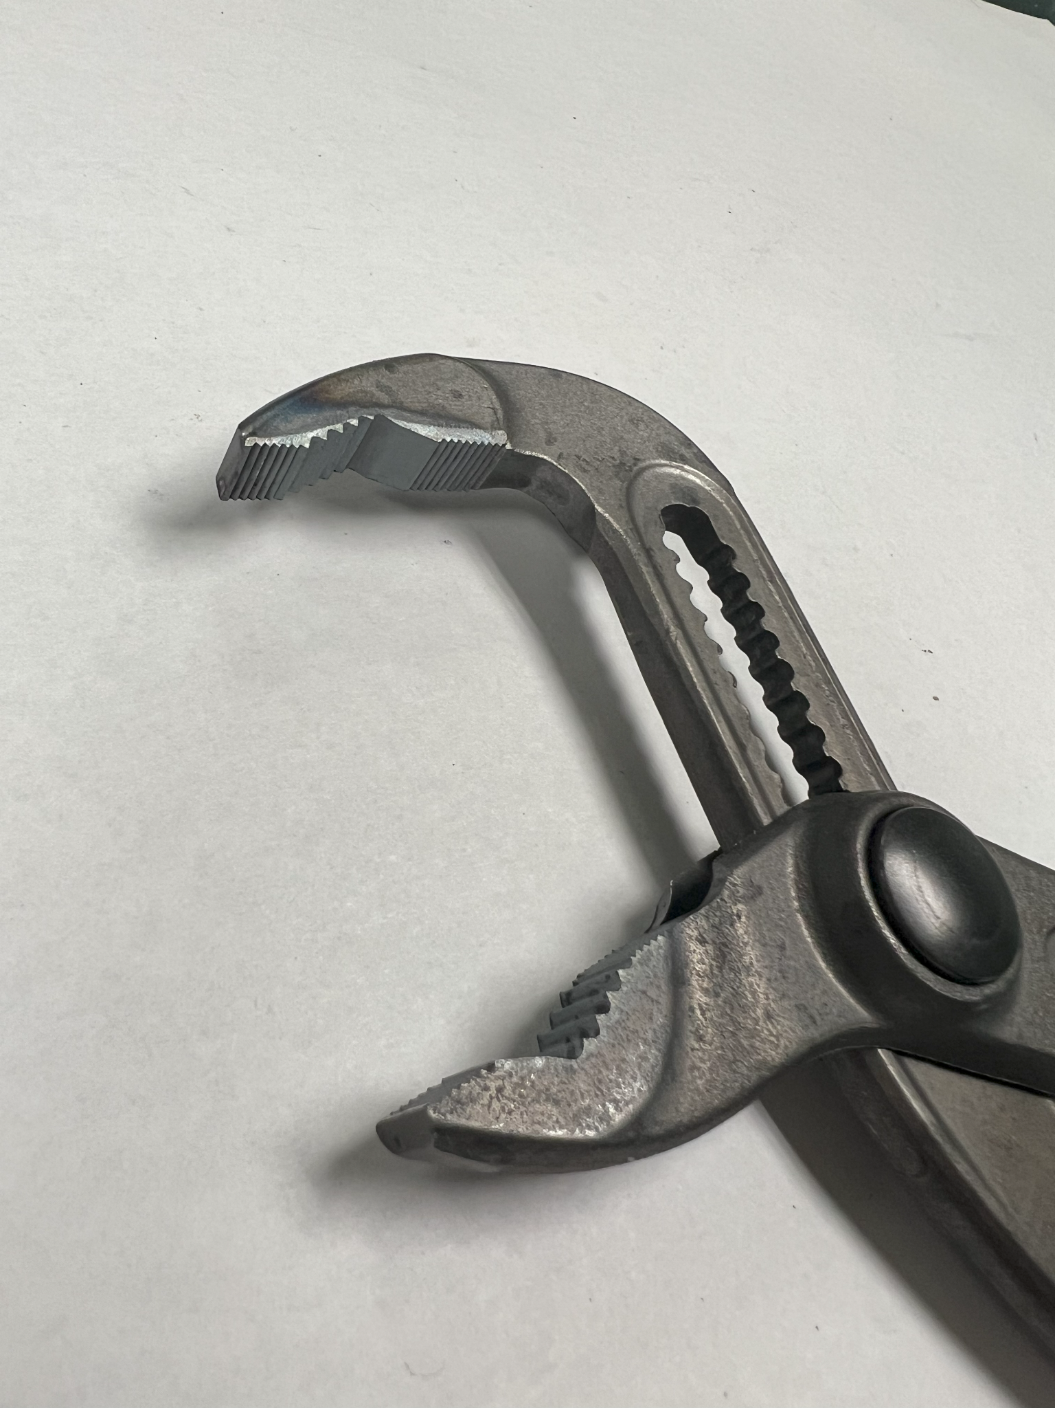
Importance of SBD-P23 [Tessa]
Before Wear
After Wear
No Secondary Heat Treatment
Secondary Heat Treatment
Notes:
Secondary hardening: if 5% improvement in lifespan but 30% in cost, get rid of process
Measures durability of plier teeth over time
Determines whether heat treatment process affects durability
Hardening on teeth specifically
Allows Stanley Black & Decker (SBD) to save time and money on manufacturing without sacrificing quality of product
Define secondary heat- hardness up

Slide 3
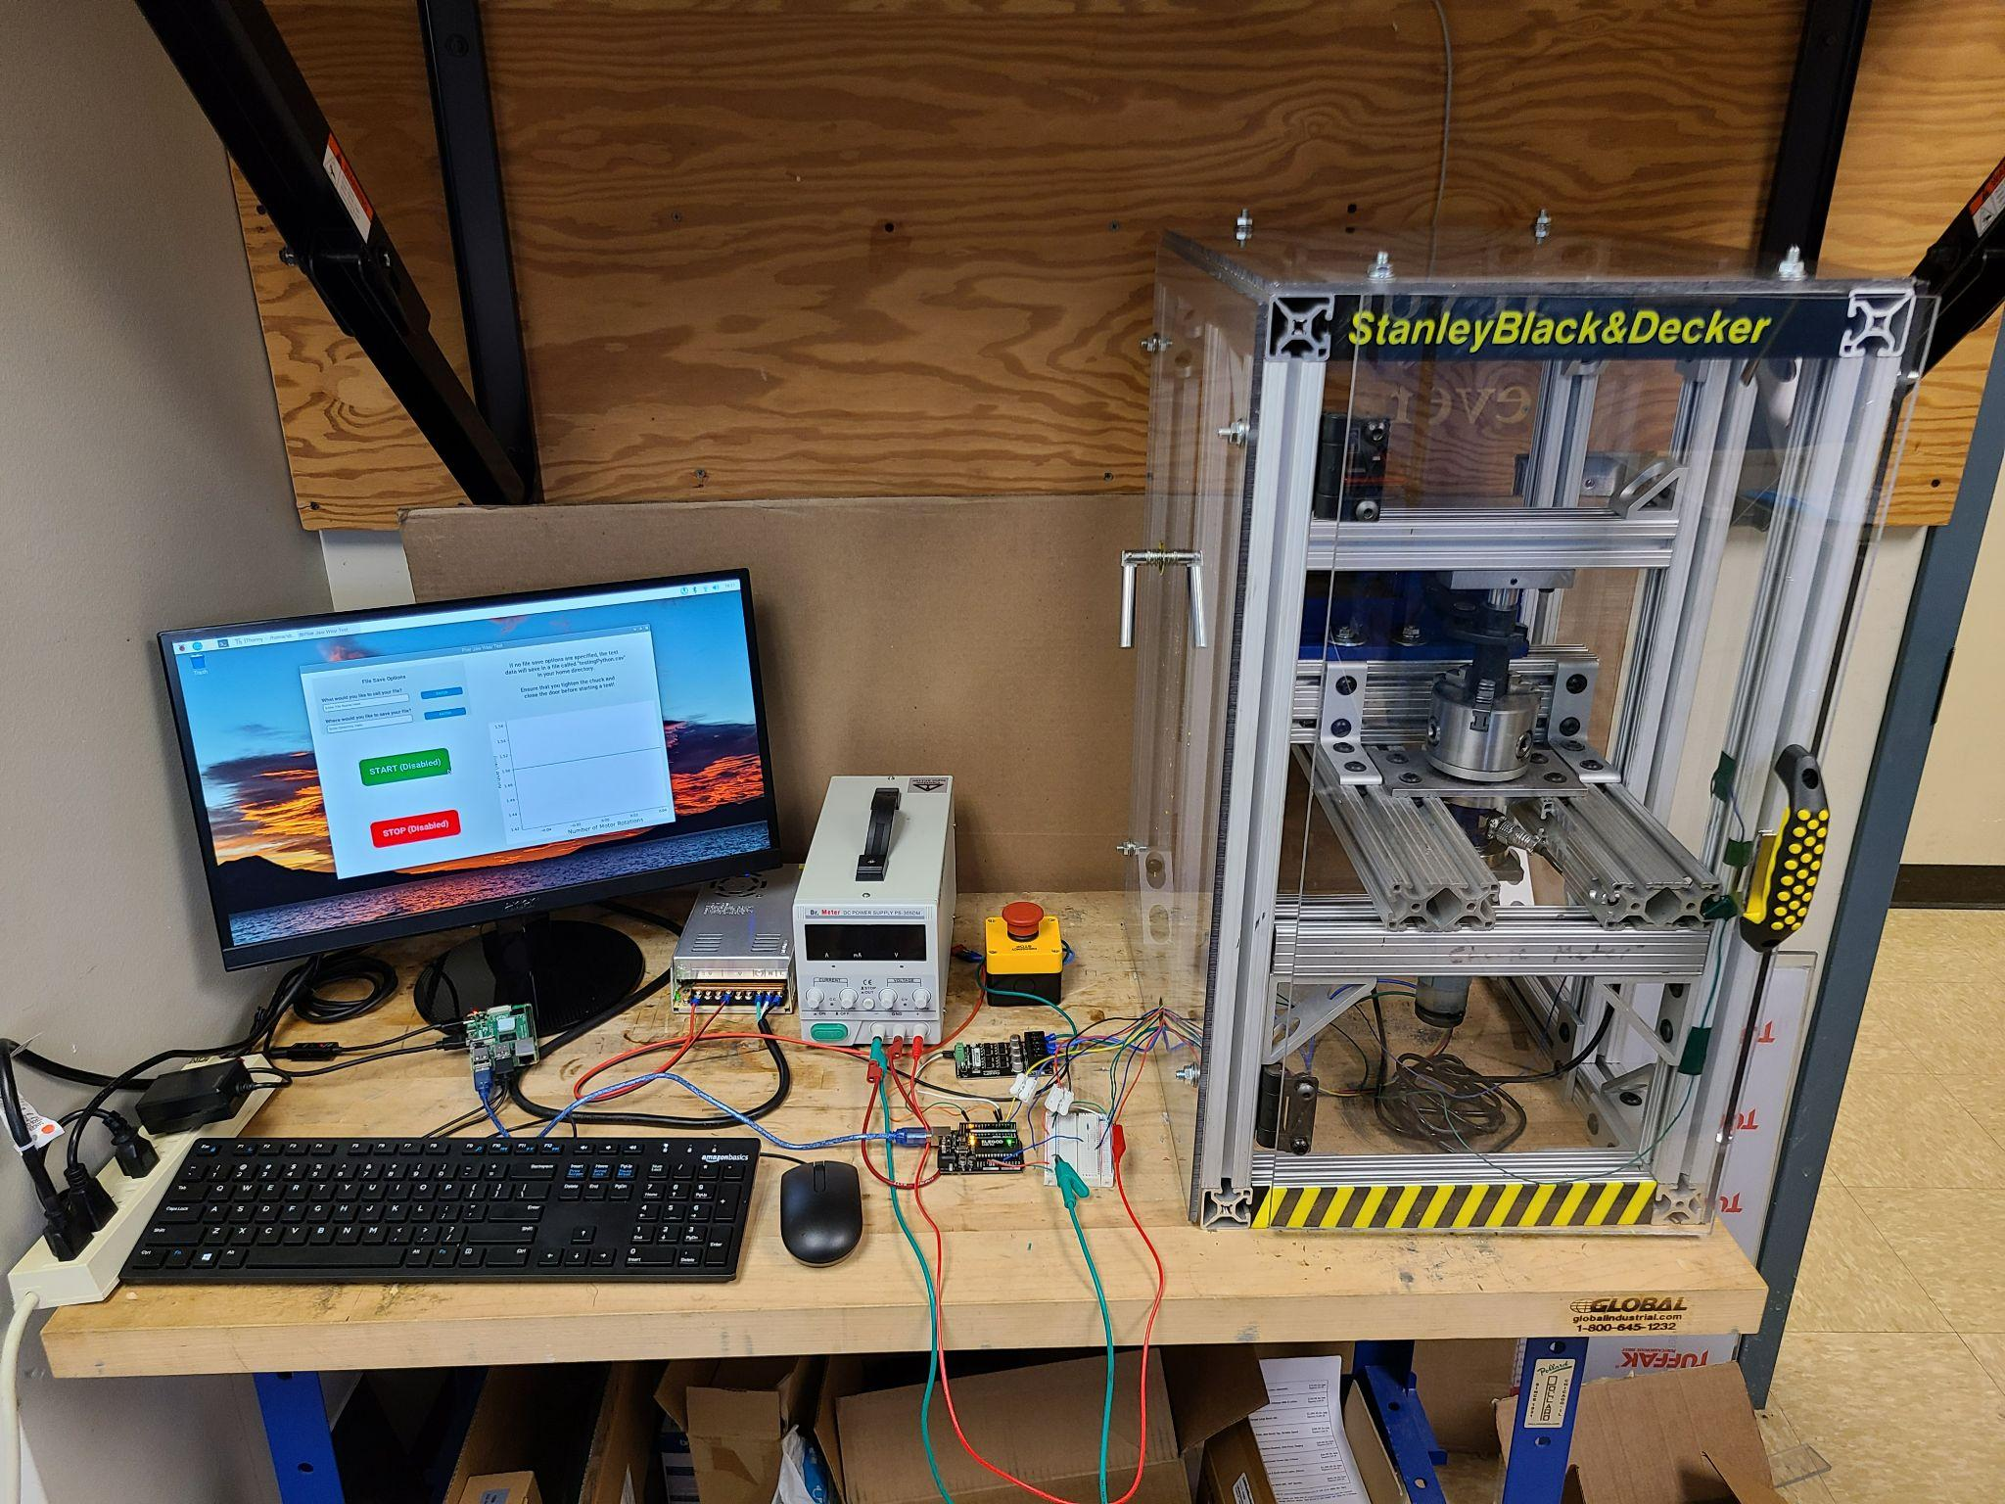
Project Goals and Requirements [Kelsey]
Consistent
Measurable
Requirements
Universal
Exchangeable
Notes:
Look at audience rather than slides
Have explanation for 7 N-m start torque
Increase size of images
Insert picture of full setup

Slide 4
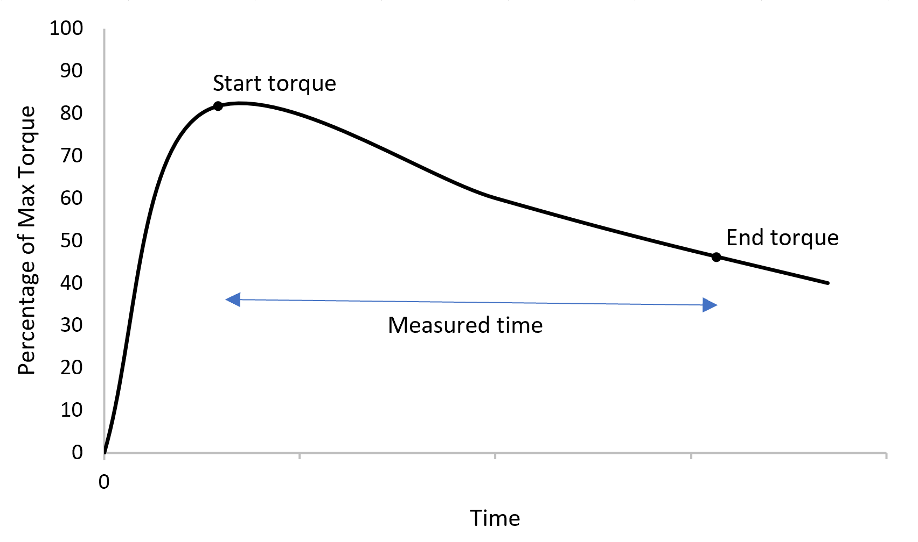
Approach to Testing [Kelsey]
Torque Cell
Motor Encoder
Number of Rotations Required for a Set Drop in Torque due to Frictional Wear
Start Torque: 7 N-m
End Torque: 3.5 N-m
Measure Number of Test Piece Rotations
Notes:
Make graph/text larger
How the test is going to run (what we’re measuring, what data we want to get out of it) → informs why the prototype is what it is
We chose to measure the change in torque due to frictional wear. Why?
-> based on user feedback
-> based on observation of pliers in SD that were old and worn
Change in torque due to frictional wear
# of rotations between chosen start and end torque
Start torque: 7 N-m
End torque: 3.5 N-m

Slide 5
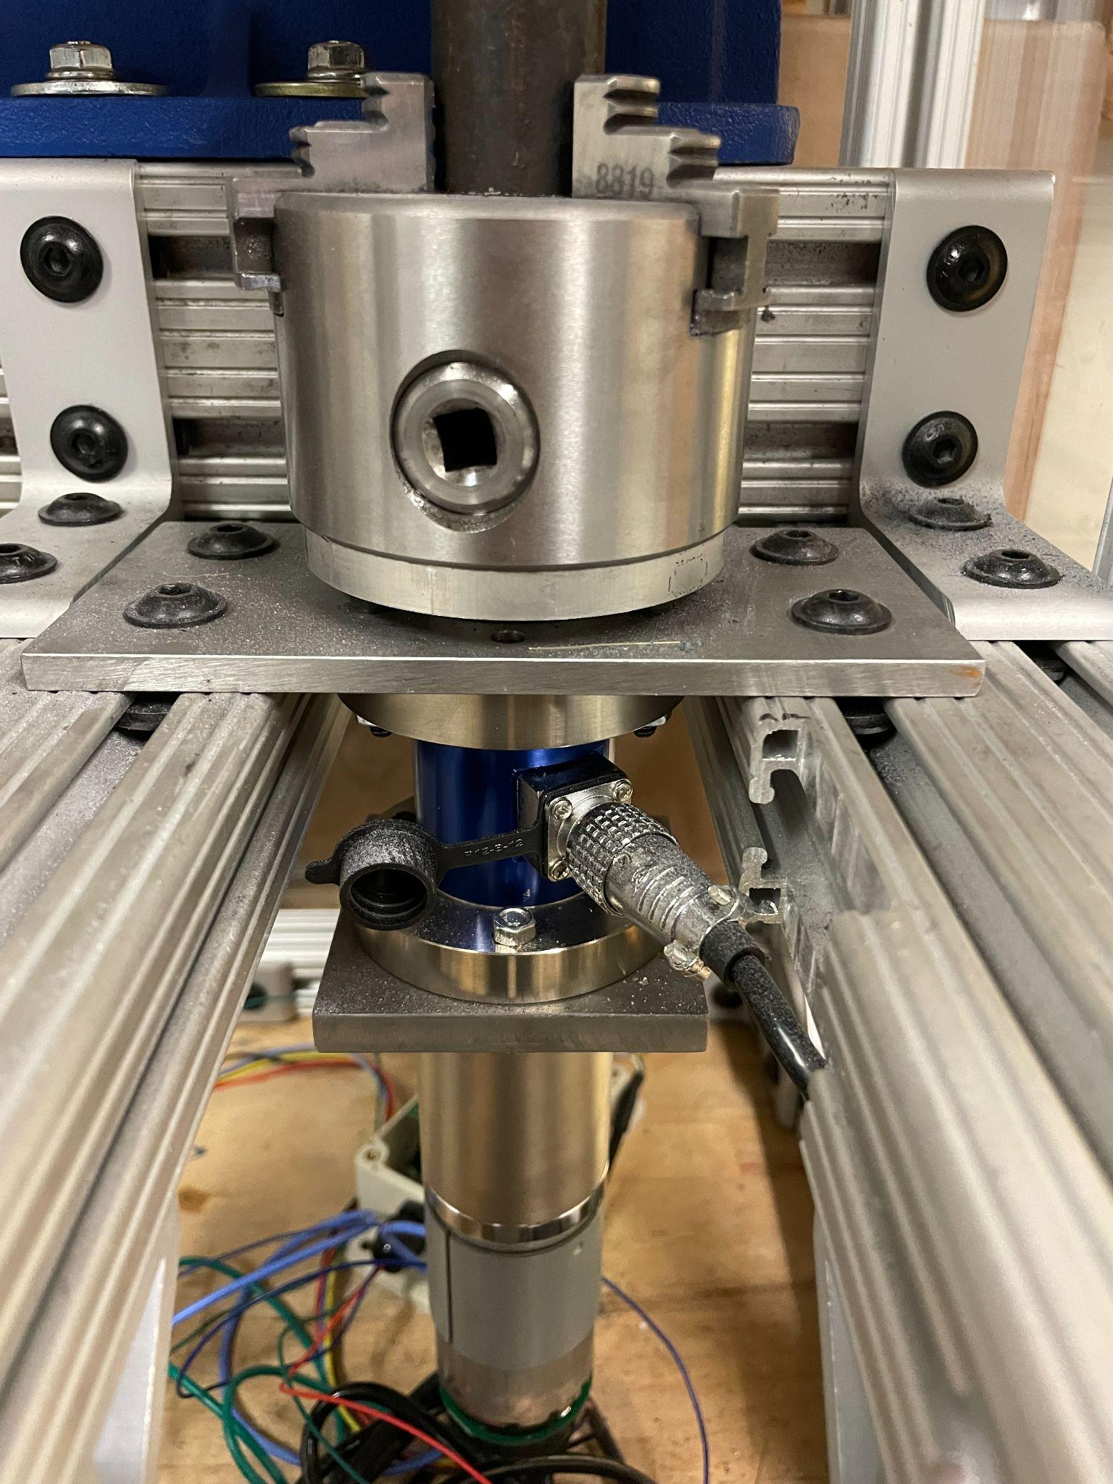
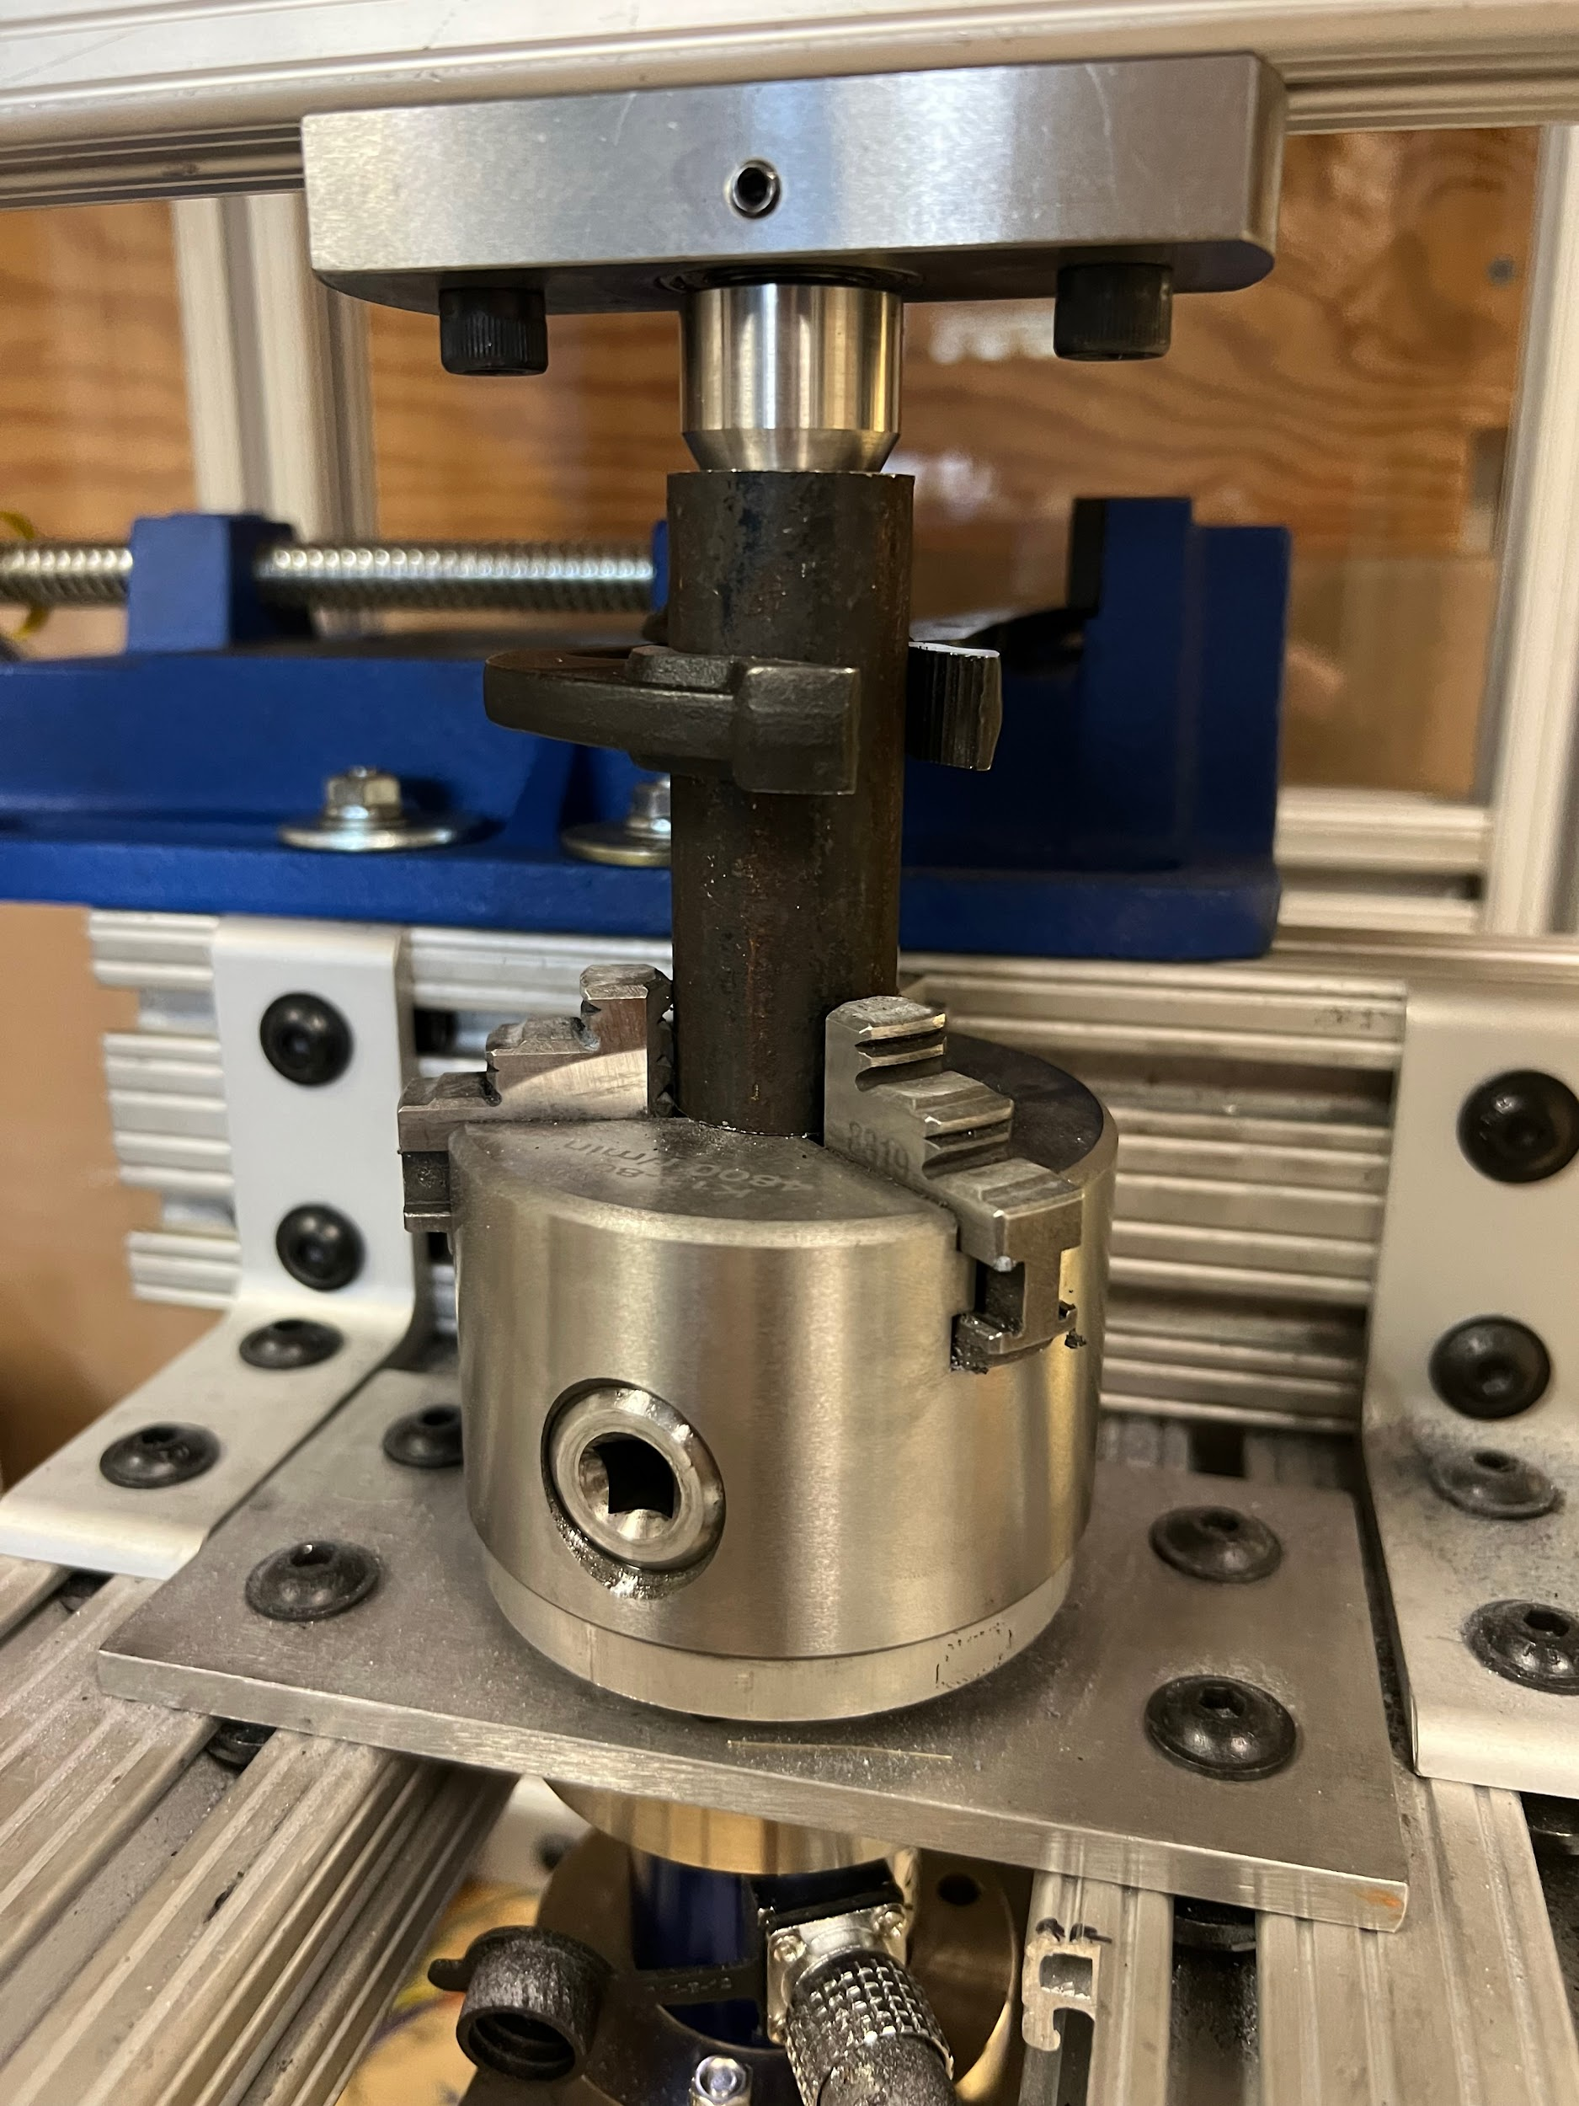
Our Design - Drivetrain [Tessa]
Chuck
Live Center
Plates
Torque Cell
Motor
Notes:
Chuck with hardened teeth
DC motor with encoder
Custom-machined parts
Adapter plates
Motor shaft to chuck adapter
Live center

Slide 6
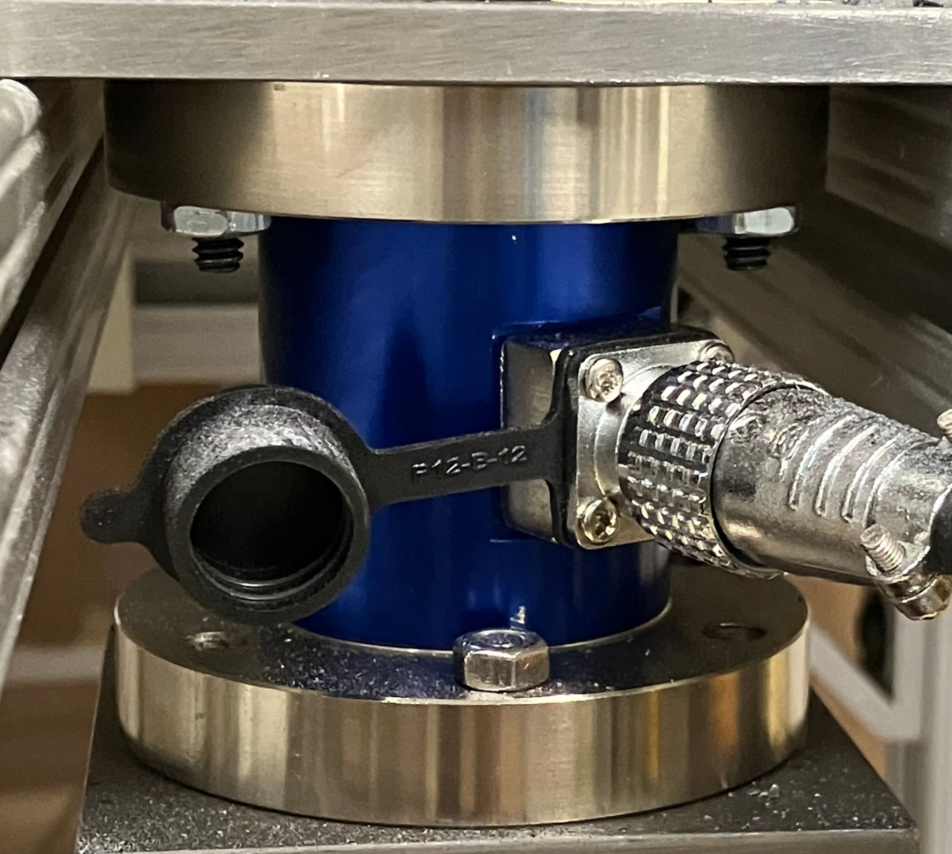
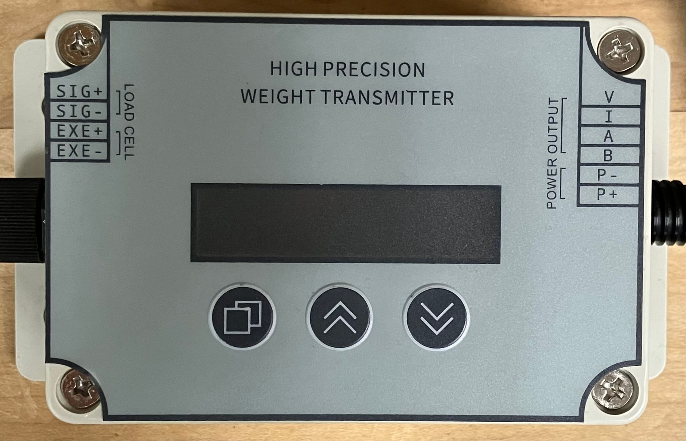
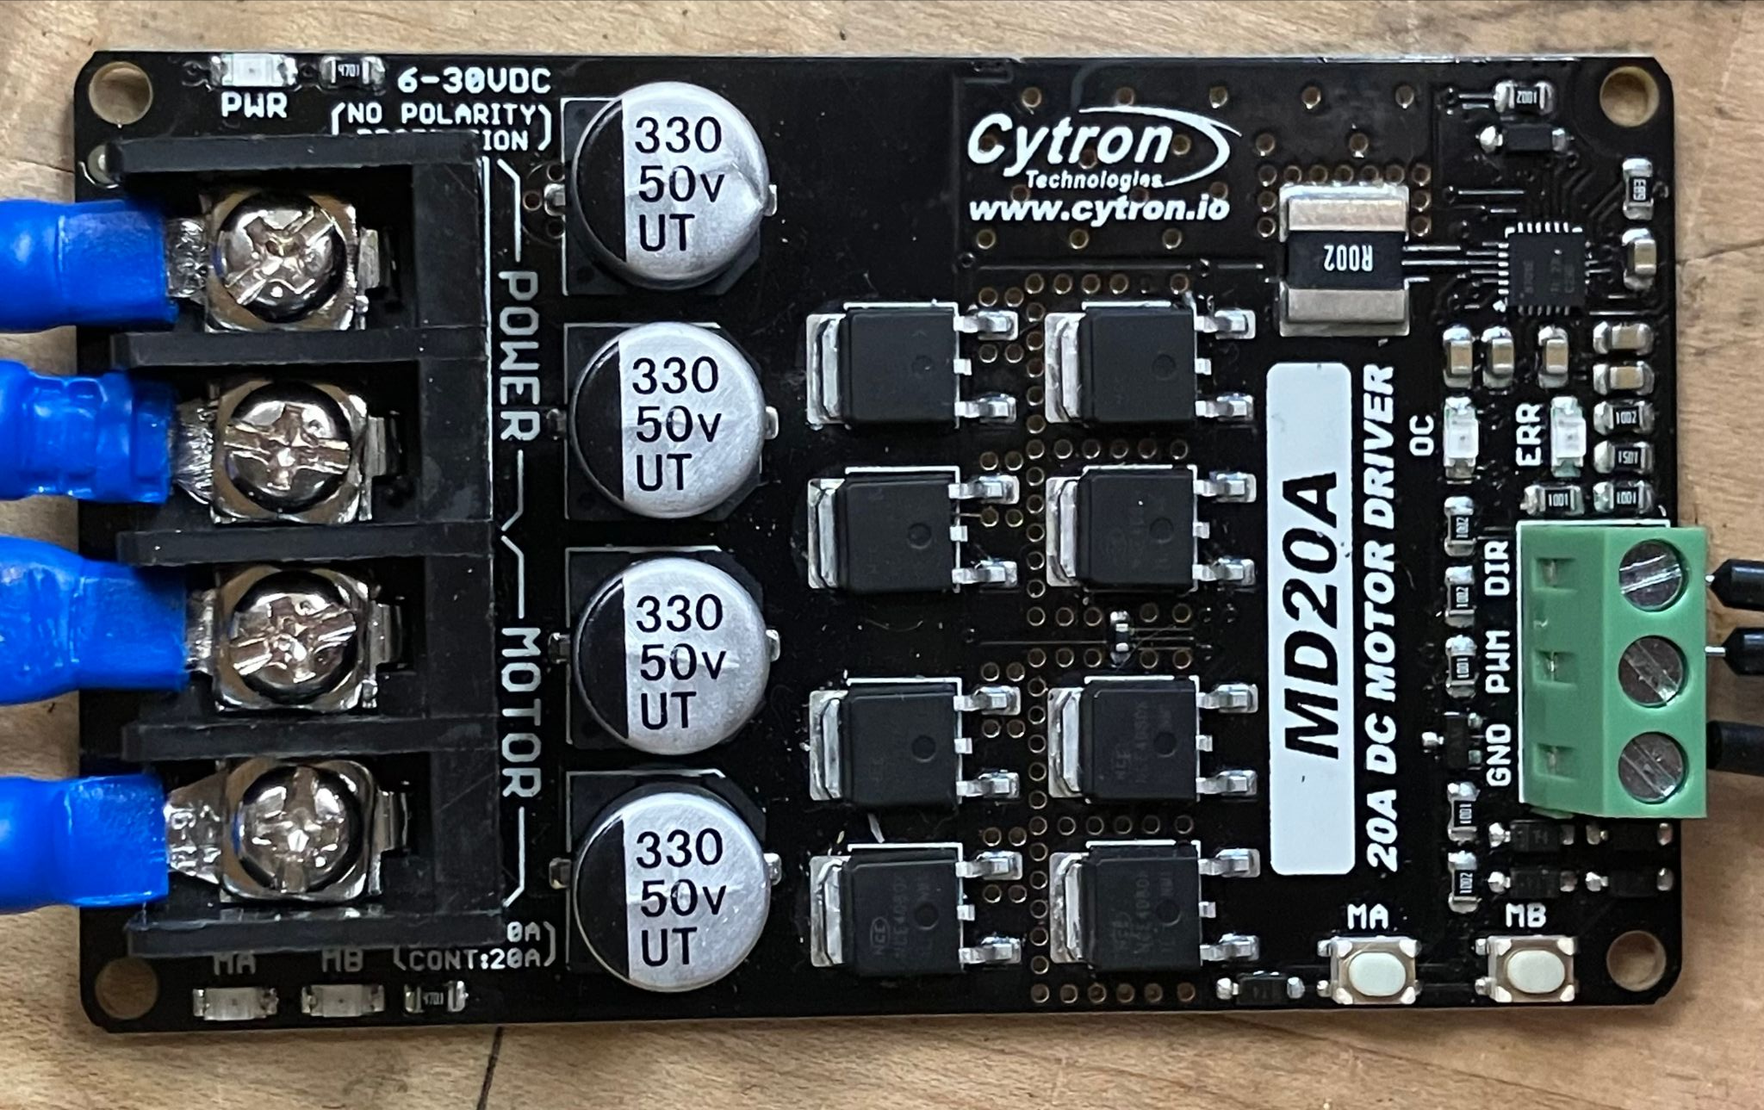
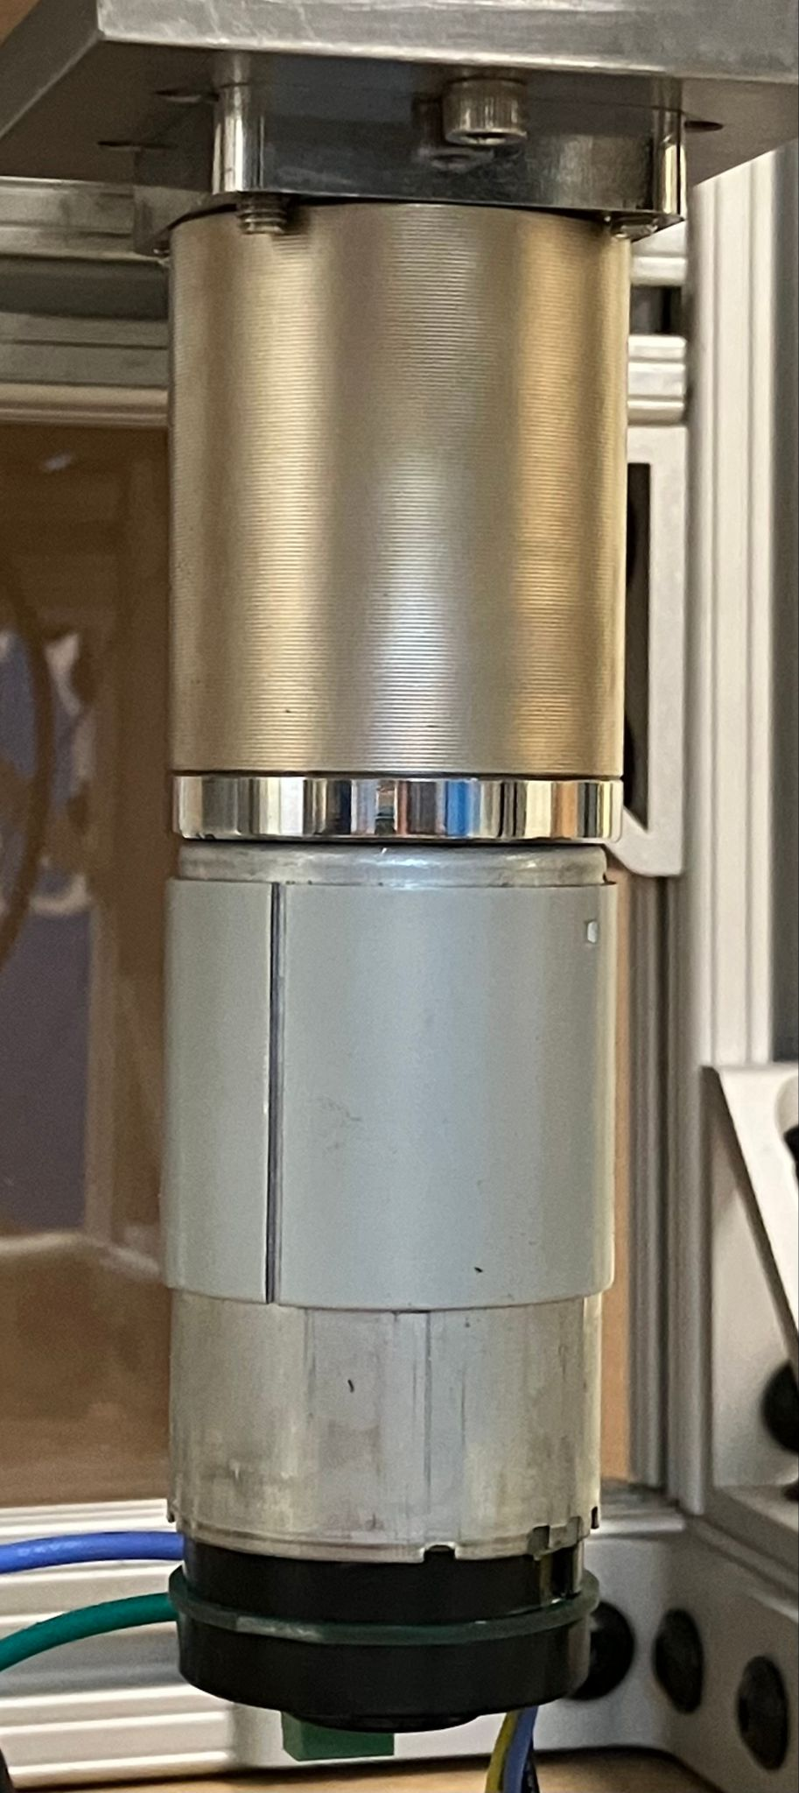
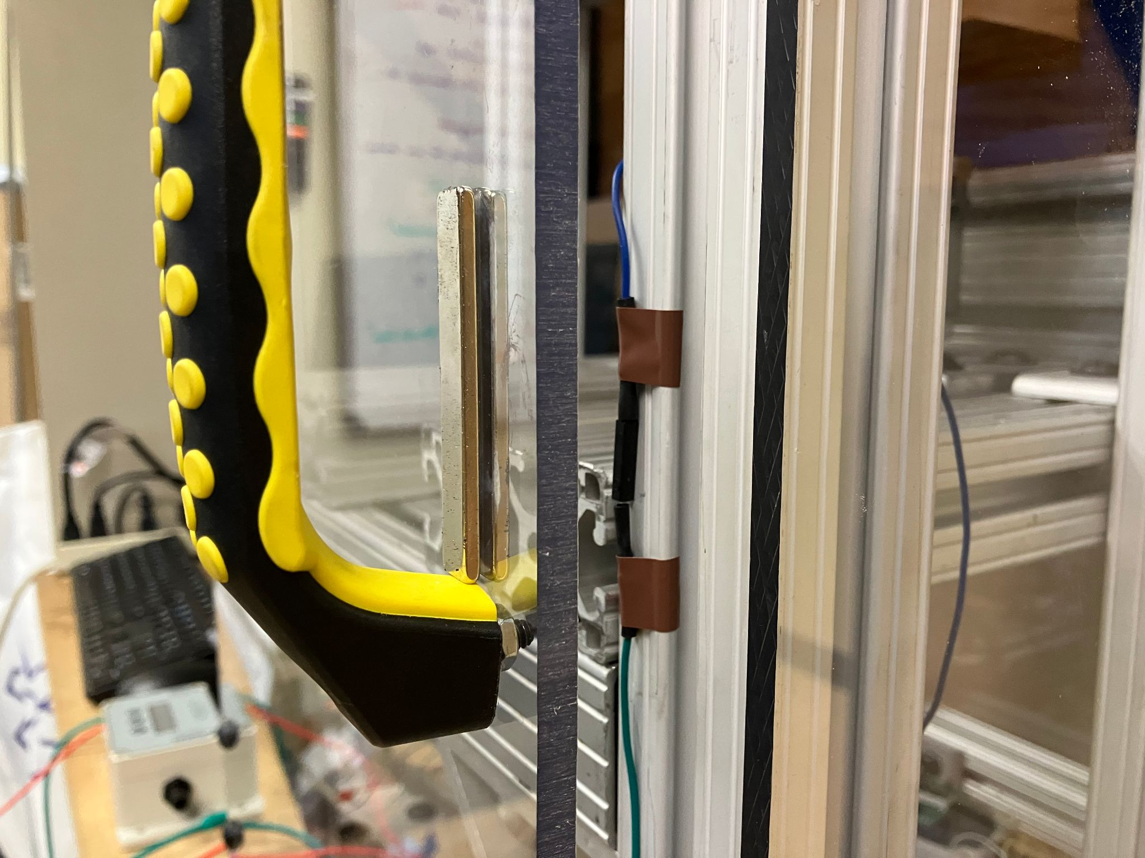
Our Design - Electronics [Sasha]
Motor Driver
DC Motor
Torque Cell
Amplifier
Arduino
Reed Switch
Encoder

Slide 7
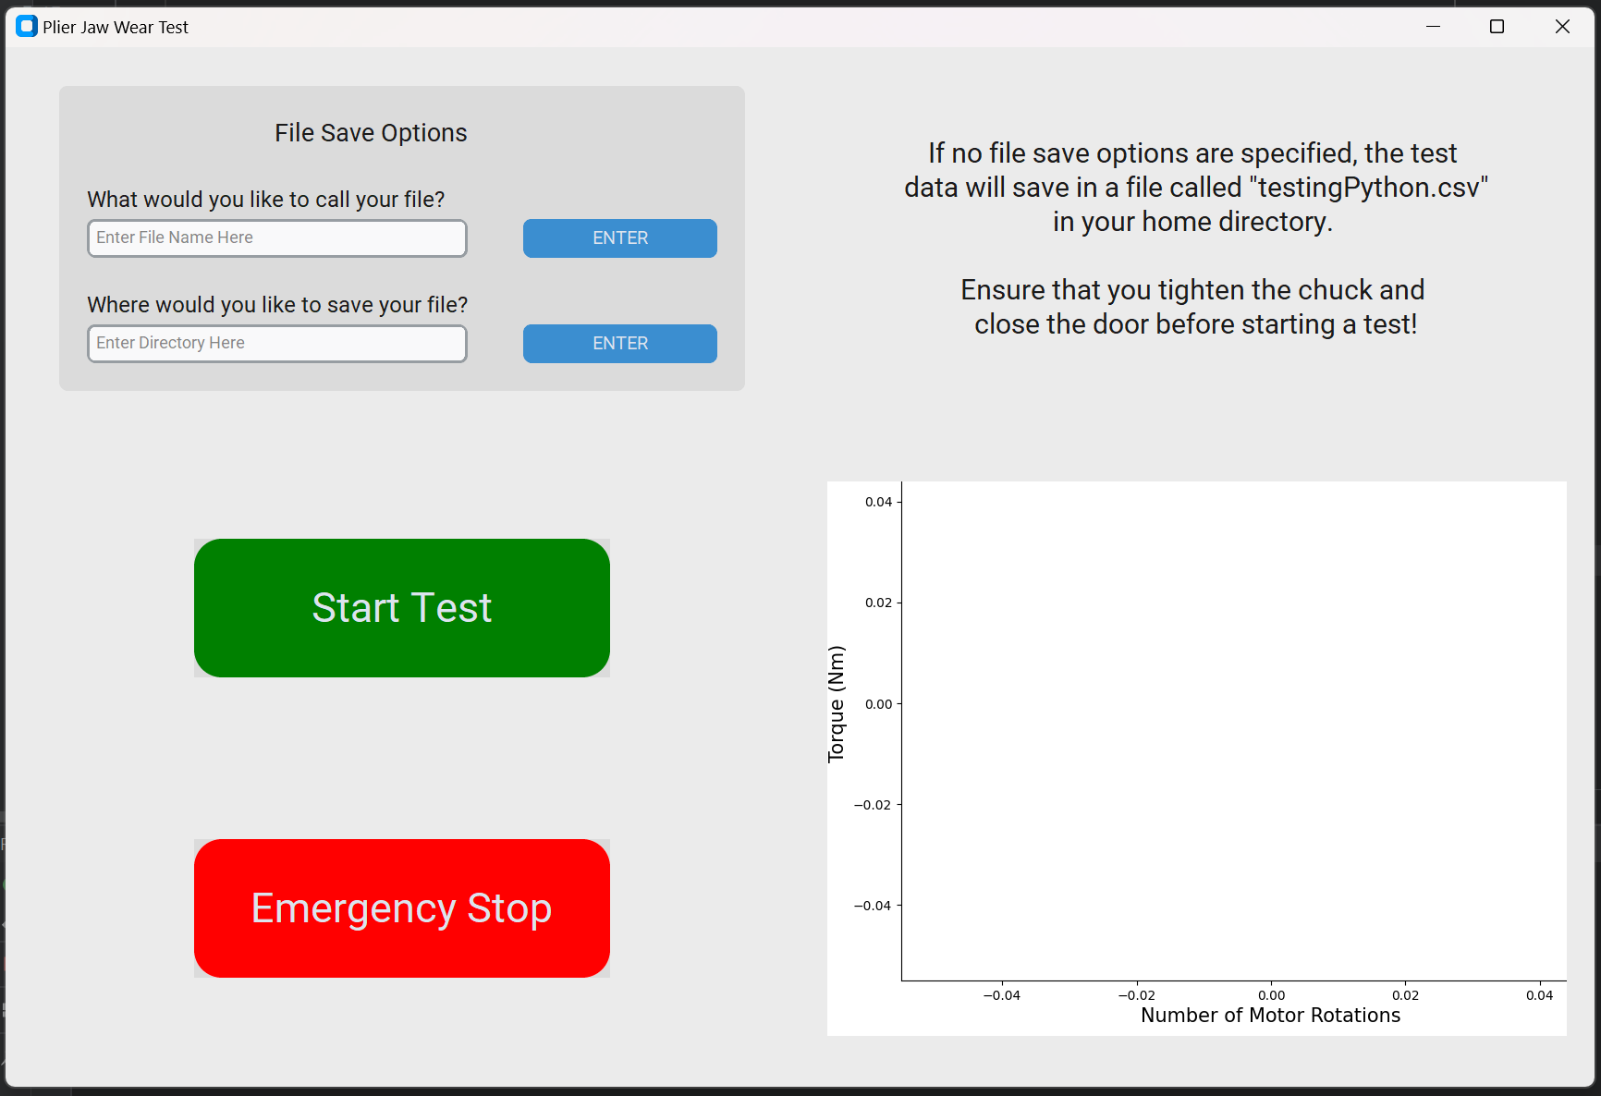
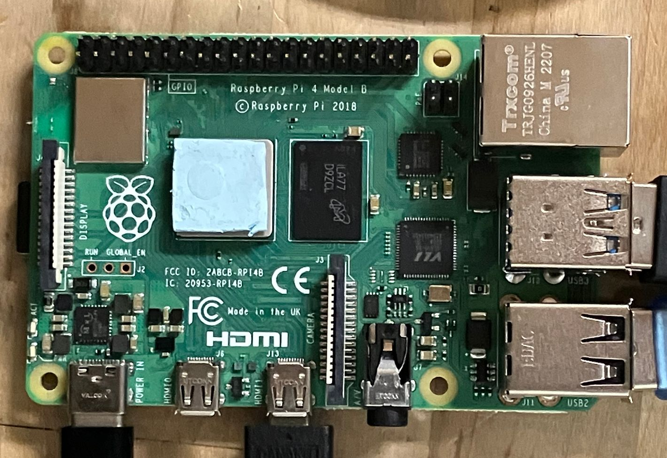
Code Integration [Sasha]
user input
commands
GUI
Raspberry Pi
Arduino
runs program
test data
sensors,
motor
operator
CSV file
Notes:
One Python file controls GUI (also Python) and communicates serially with Arduino
High-level overview (what’s in comments)
User only has to run one Python file, then interface with GUI, then you get output data saved into a CSV

Slide 8
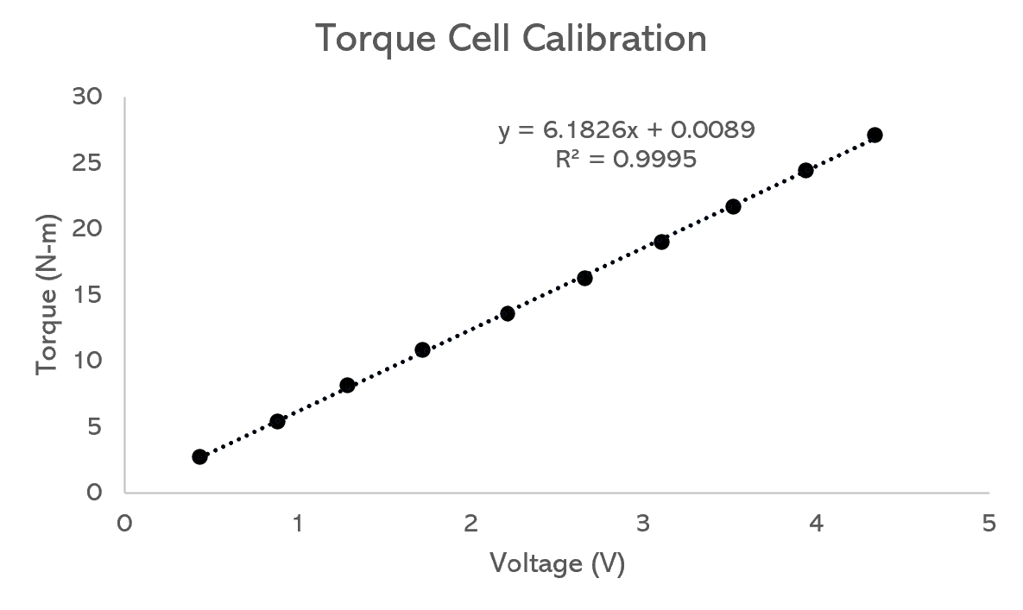
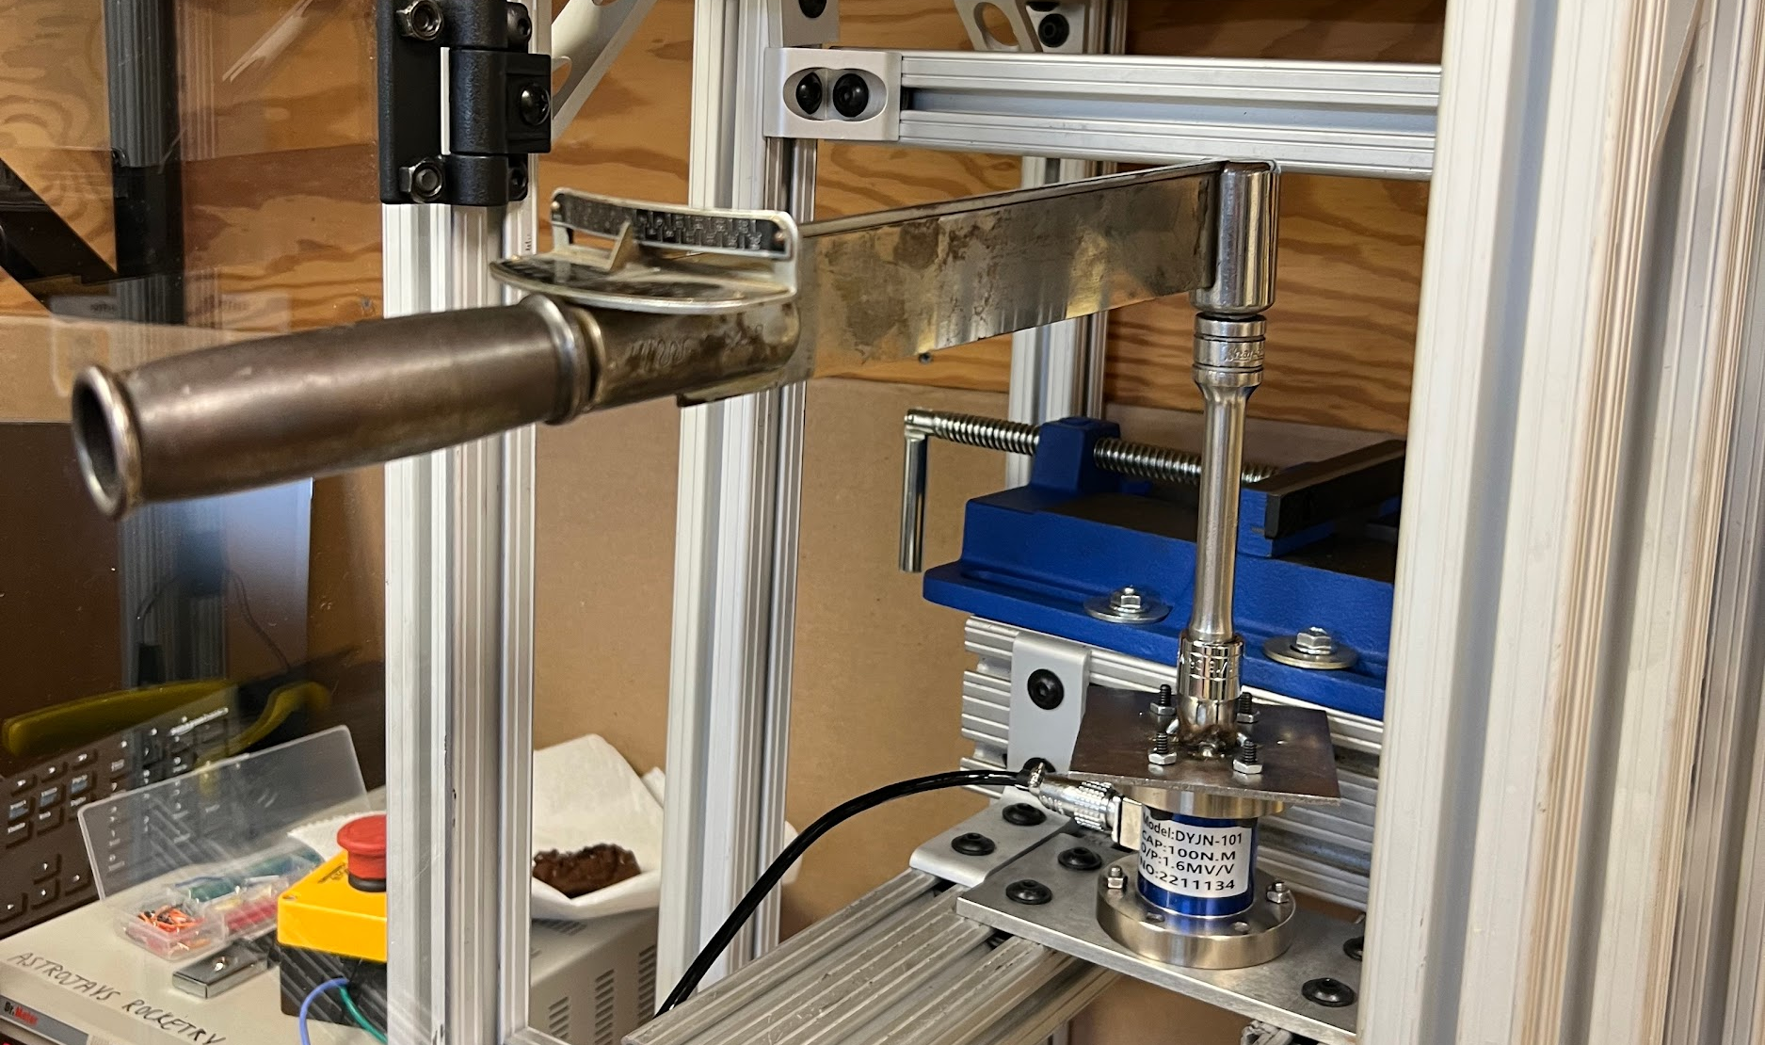
Torque Cell Calibration [Katharine]
Torque Cell Calibration
Consistent Wear Test
Plier Universality
Variable Test Piece Diam
Safety Test
Durability Test
Temp of Test Piece
Environment Temp Test
Usability Test
Notes:
Intro ptvr in here
Explain how we tested the testing rig itself

Slide 9
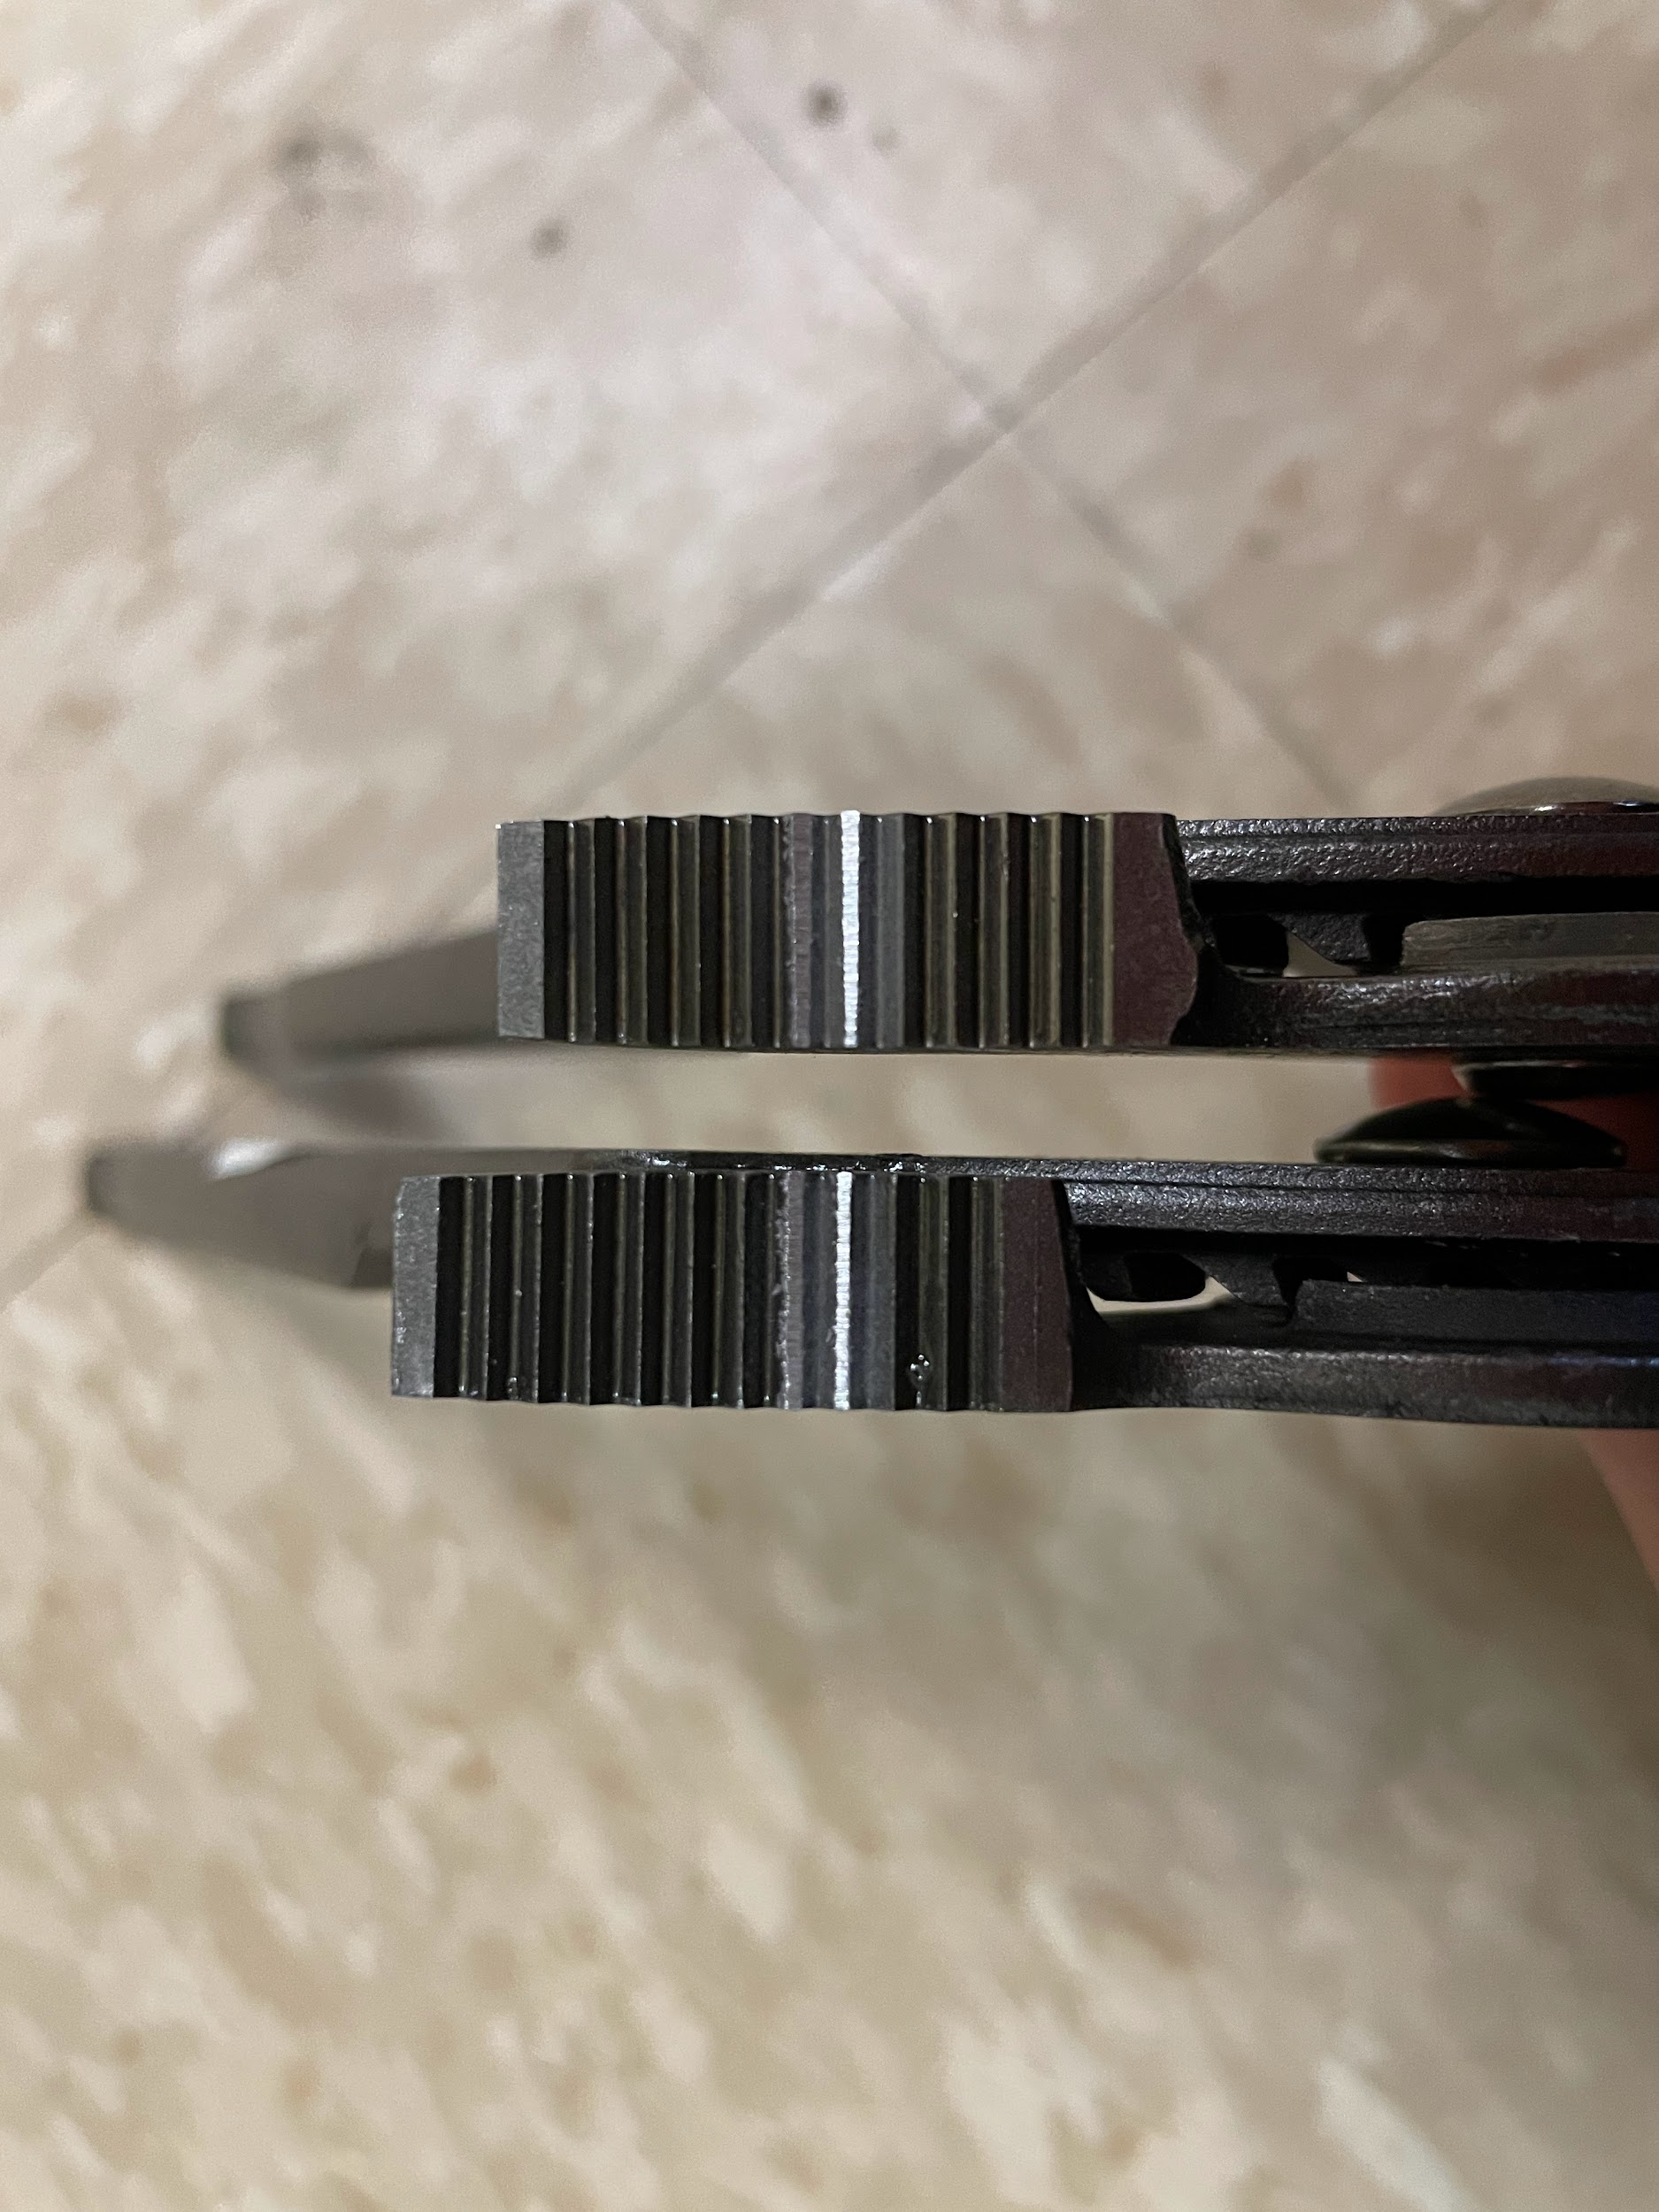
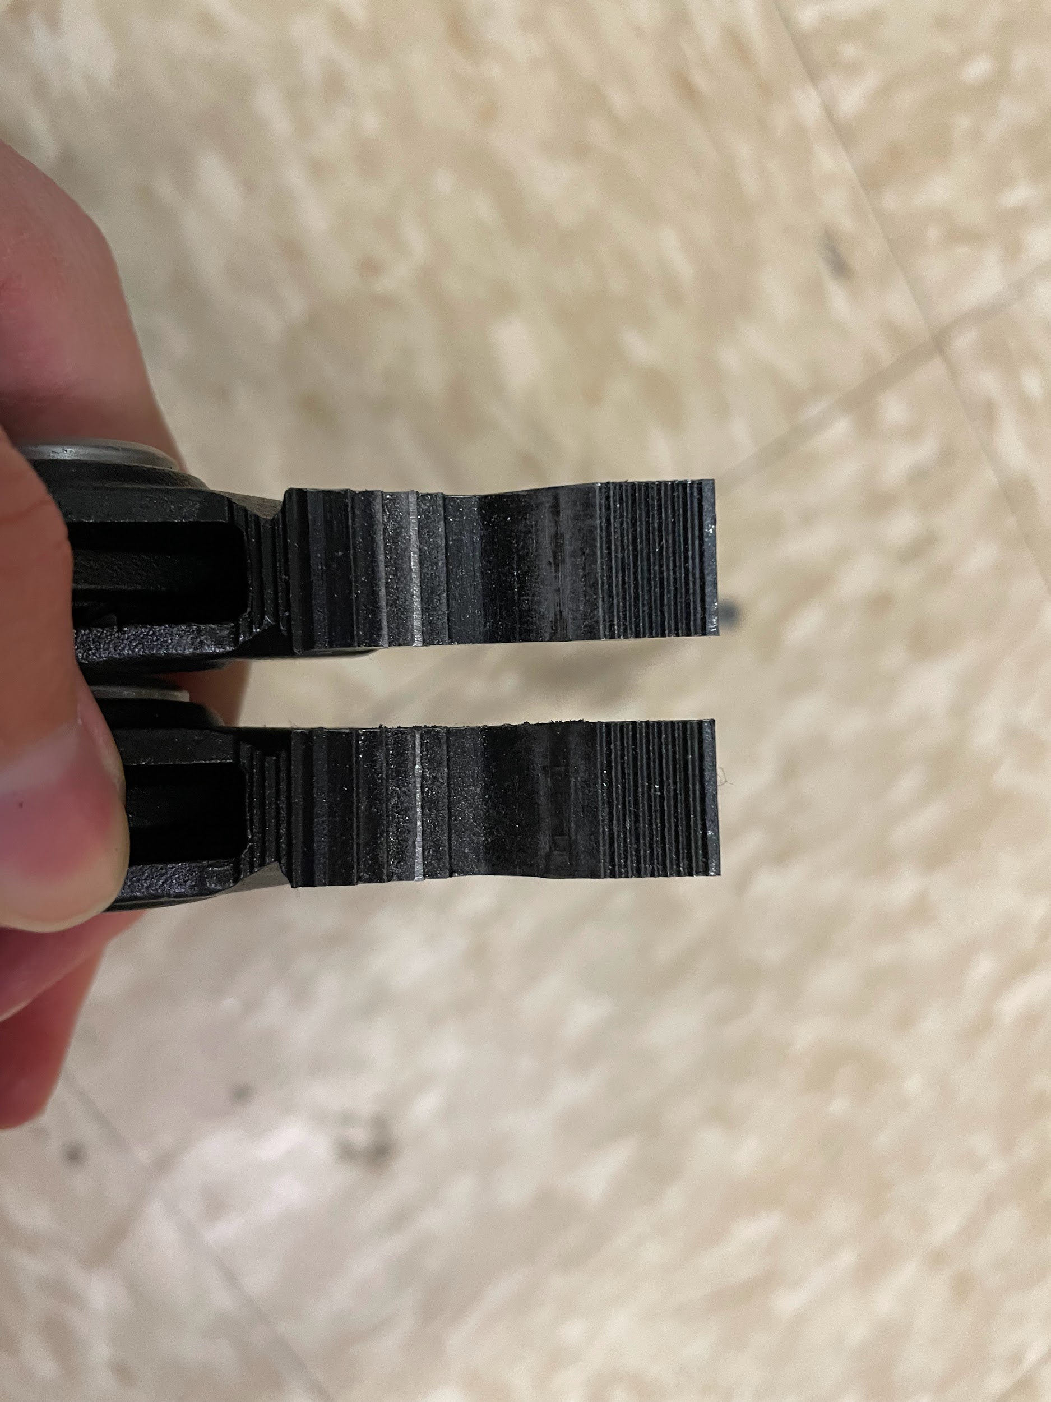
Consistent Wear Test [Tessa]
Torque Cell Calibration
Consistent Wear Test
Plier Universality
Variable Test Piece Diam
Safety Test
Durability Test
Temp of Test Piece
Environment Temp Test
Usability Test
Notes:
What do we say for consistent wear test?
Visually confirmed wear was in approximately the same place and similar depth for same pliers mounted in the same way
Consistent against identical pliers- not different types
In future slides we will explain the remaining adjustments needed to prove the wear is statistically similar using survival analysis

Slide 10
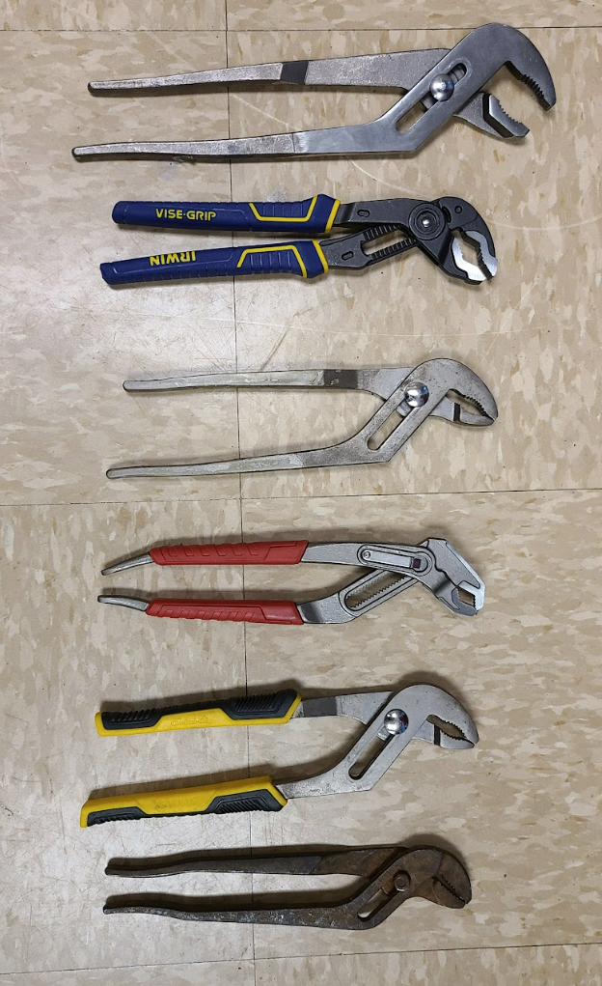
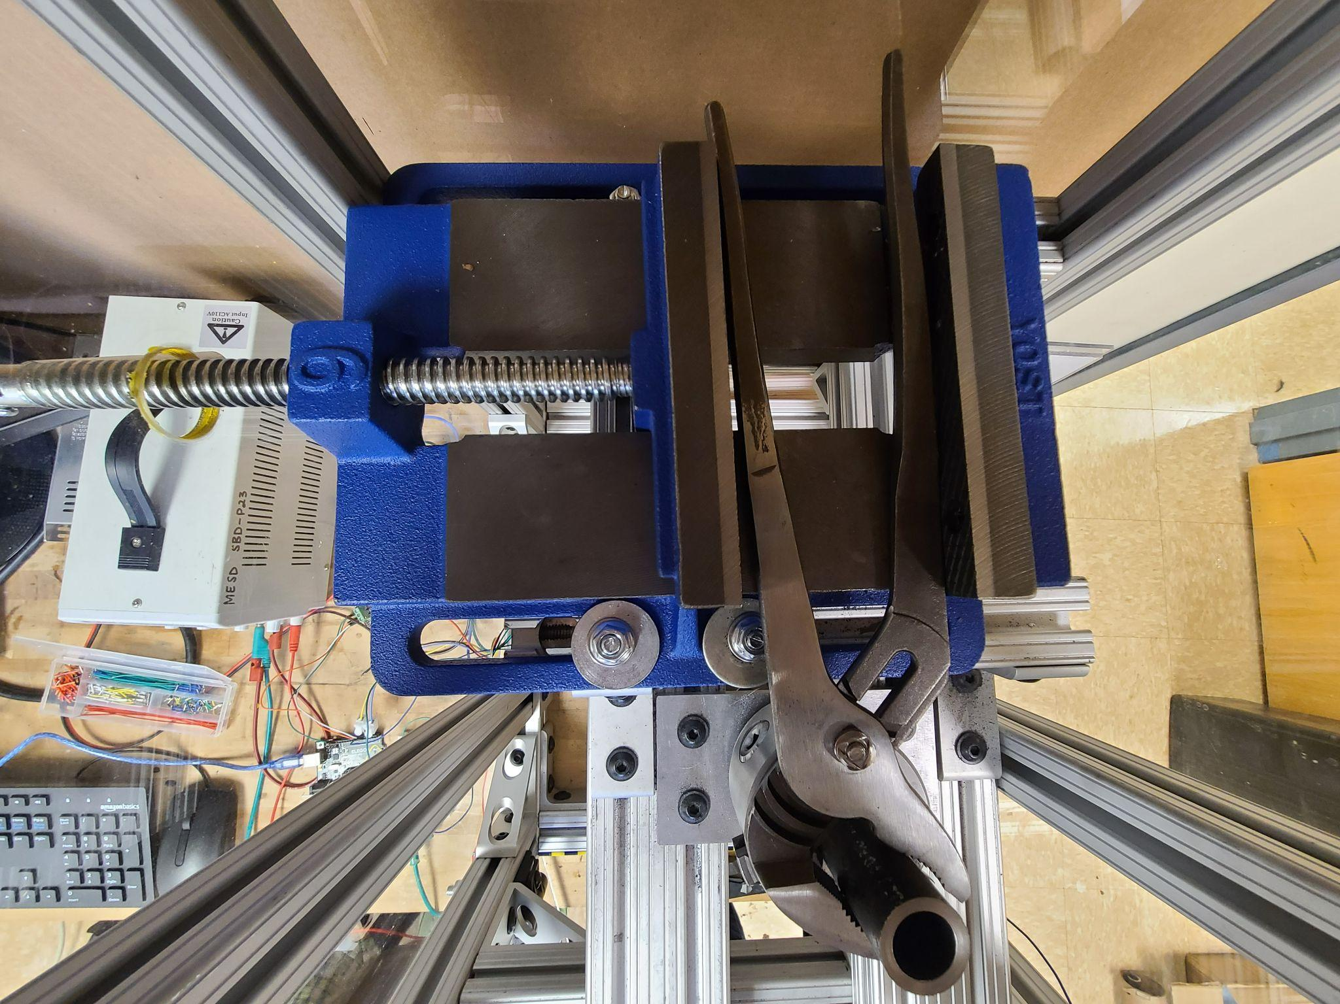
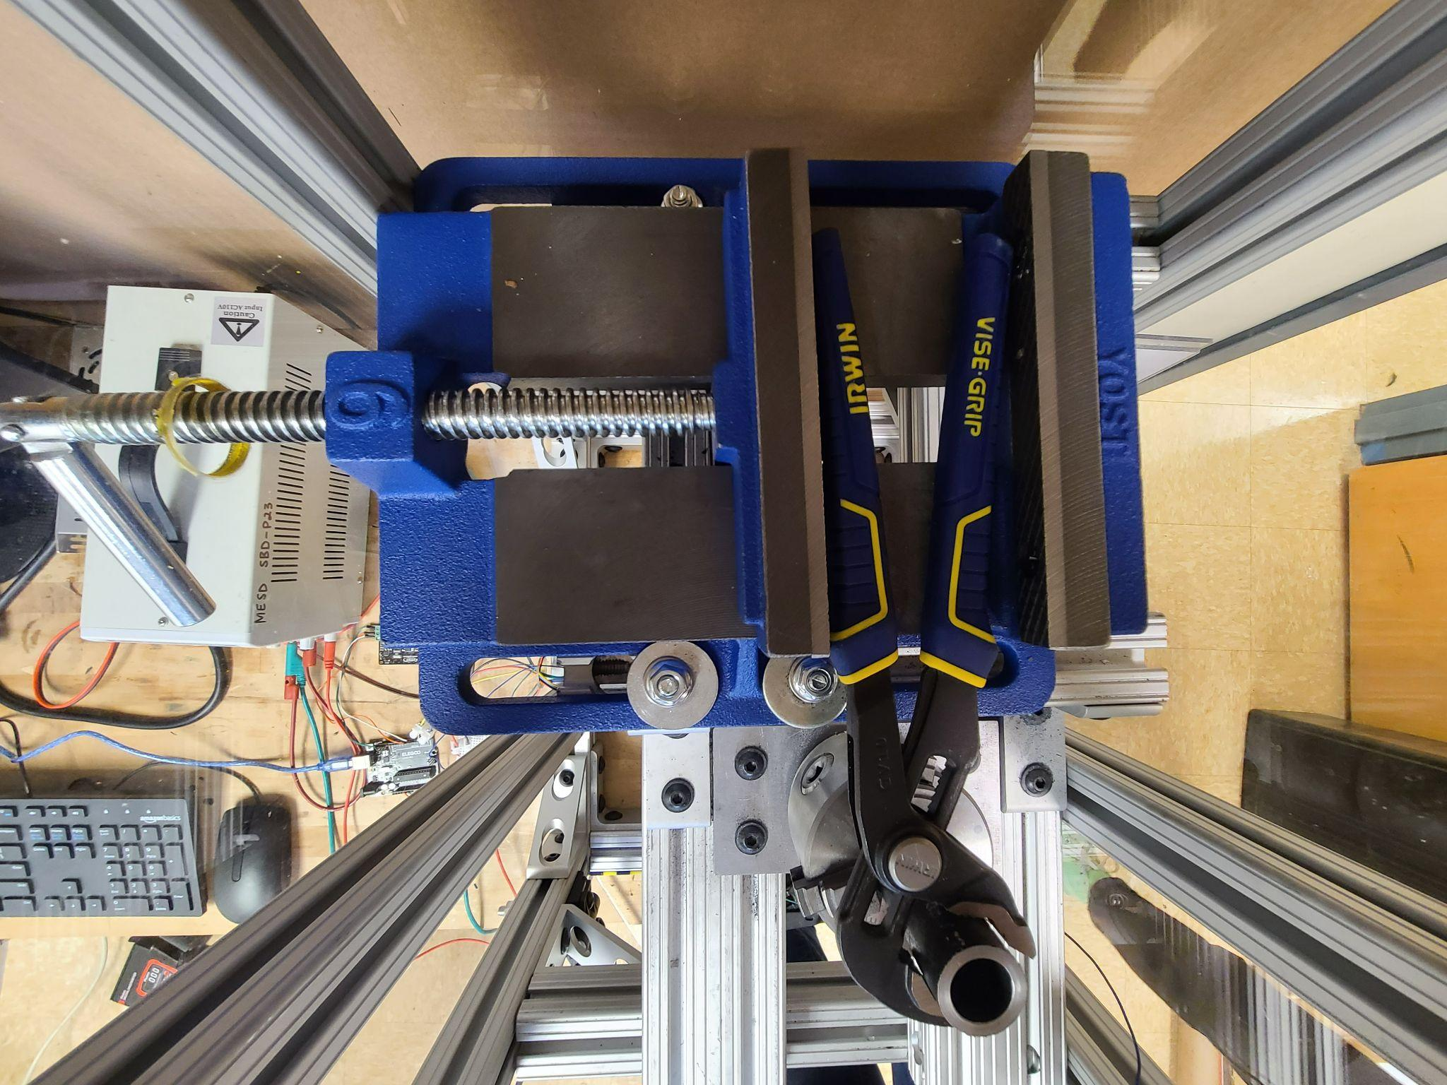
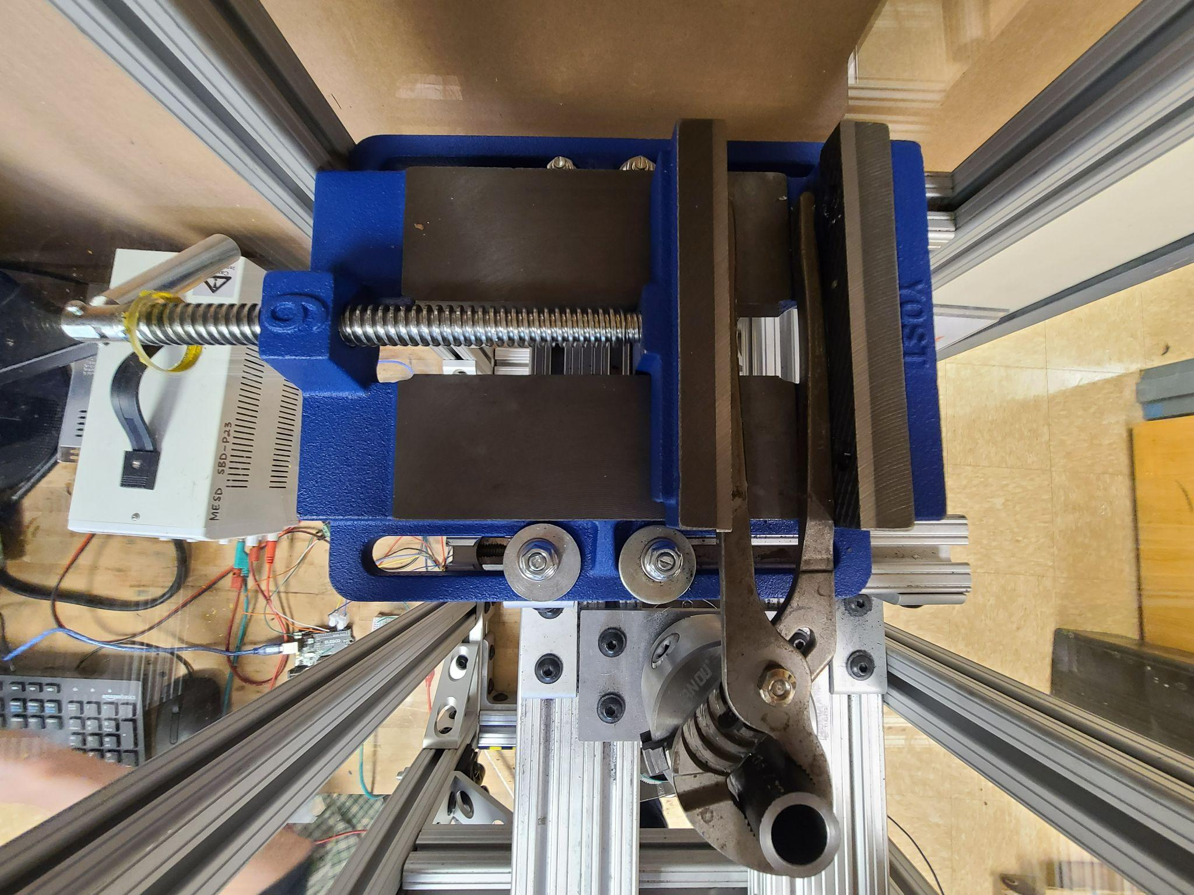
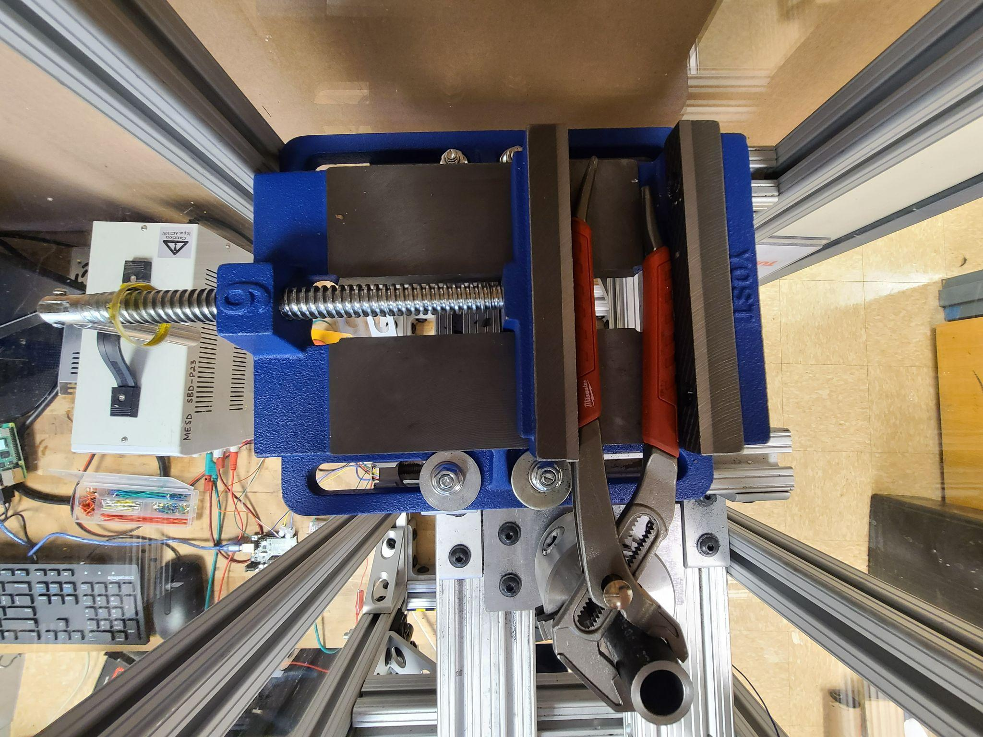
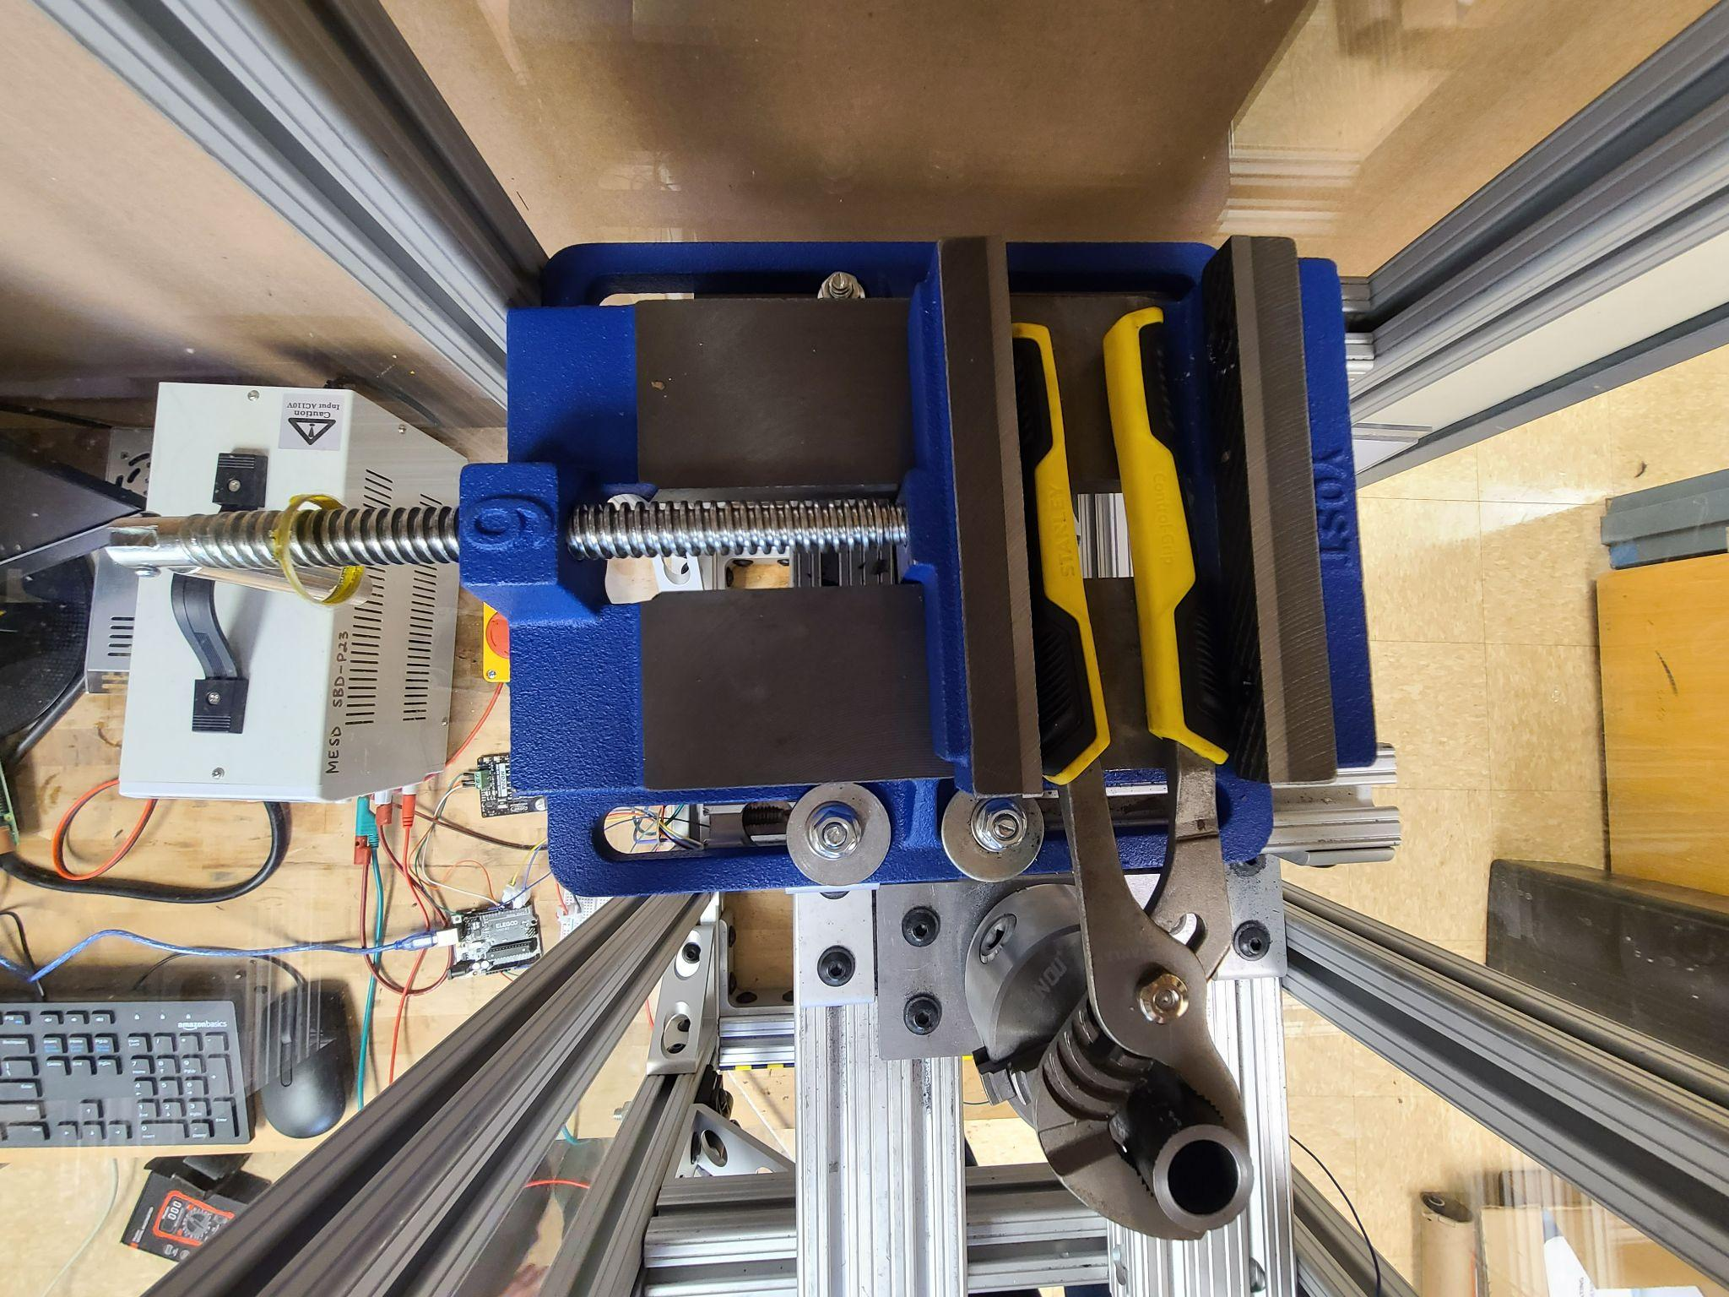
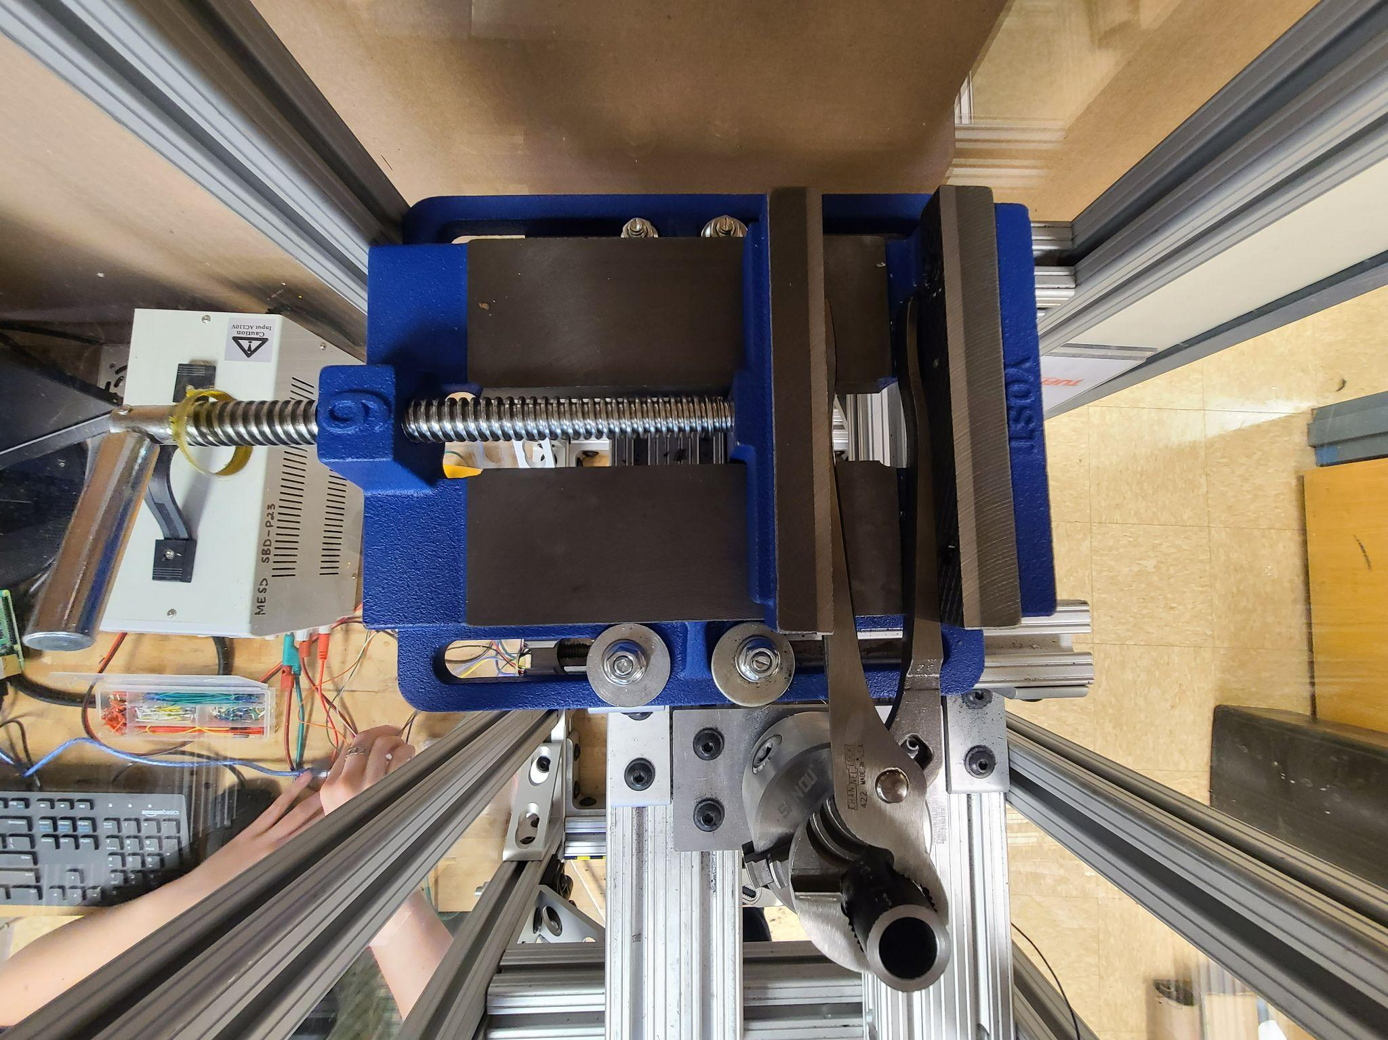
Plier Universality [Tessa]
Torque Cell Calibration
Consistent Wear Test
Plier Universality
Variable Test Piece Diam
Safety Test
Durability Test
Temp of Test Piece
Environment Temp Test
Usability Test

Slide 11
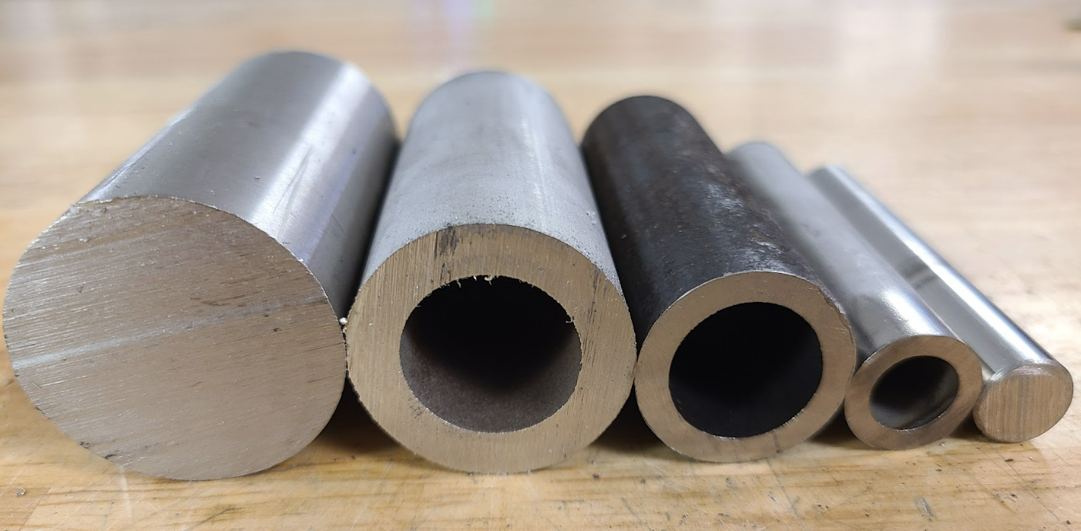
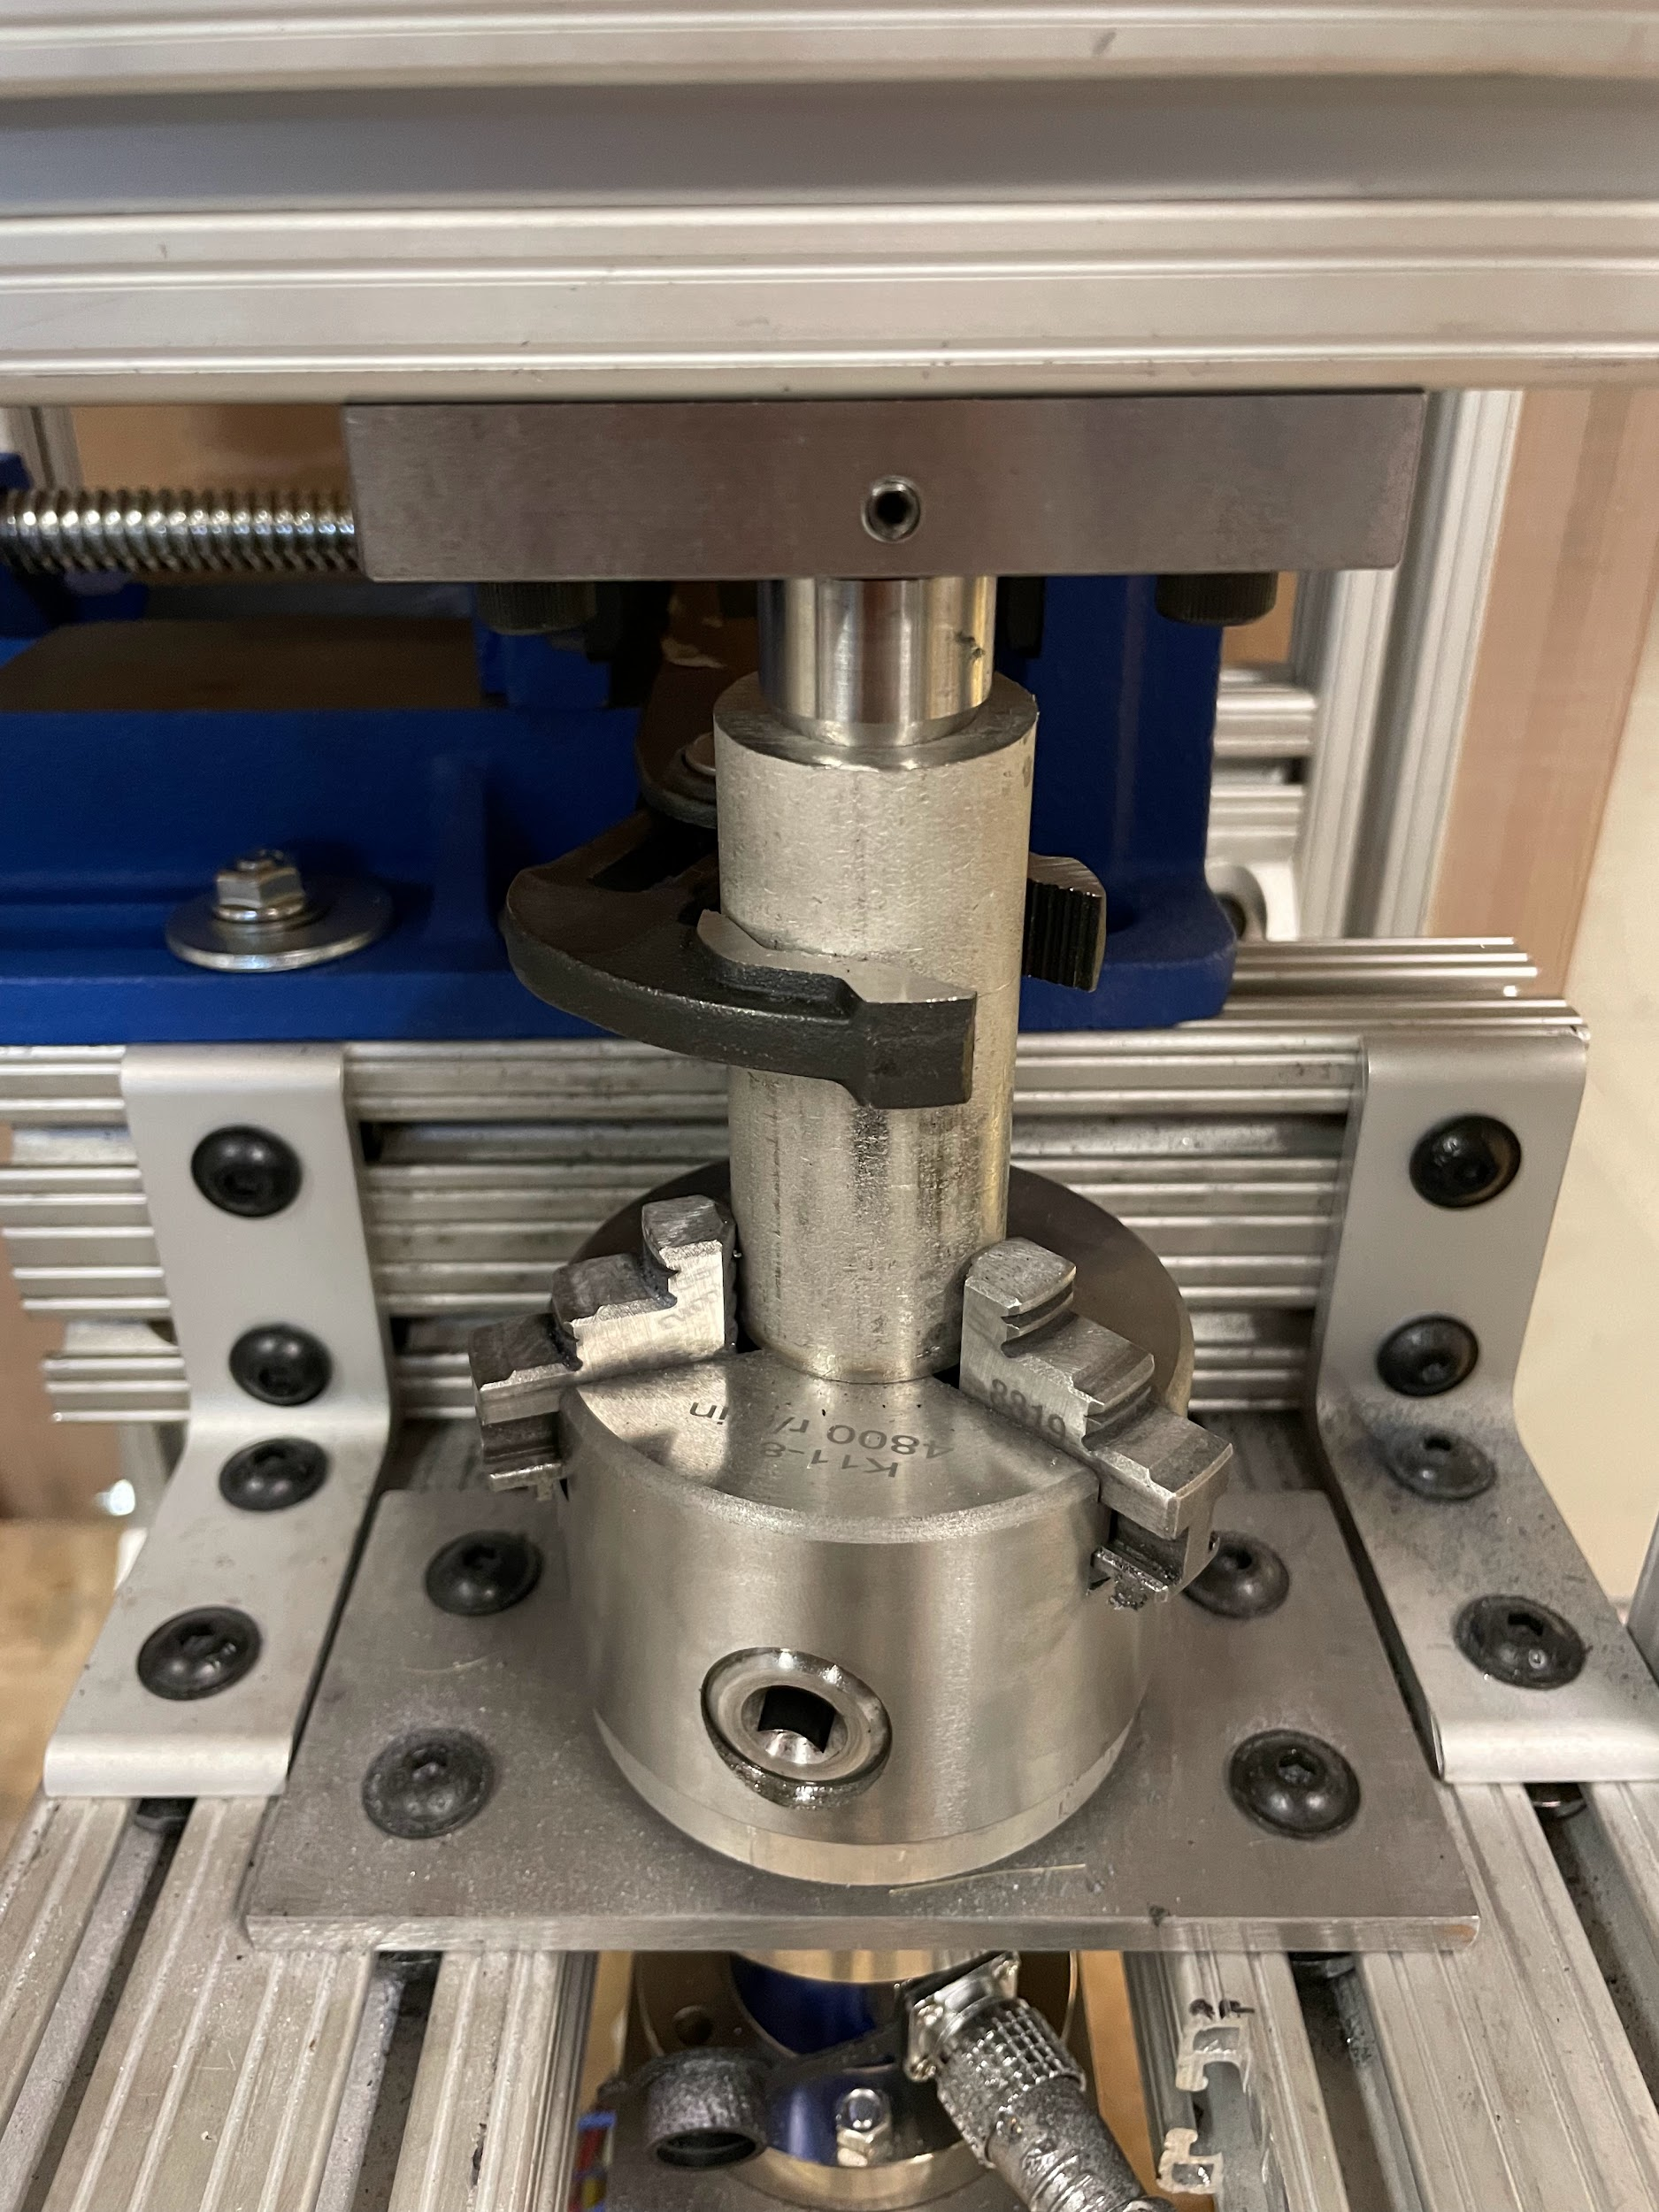
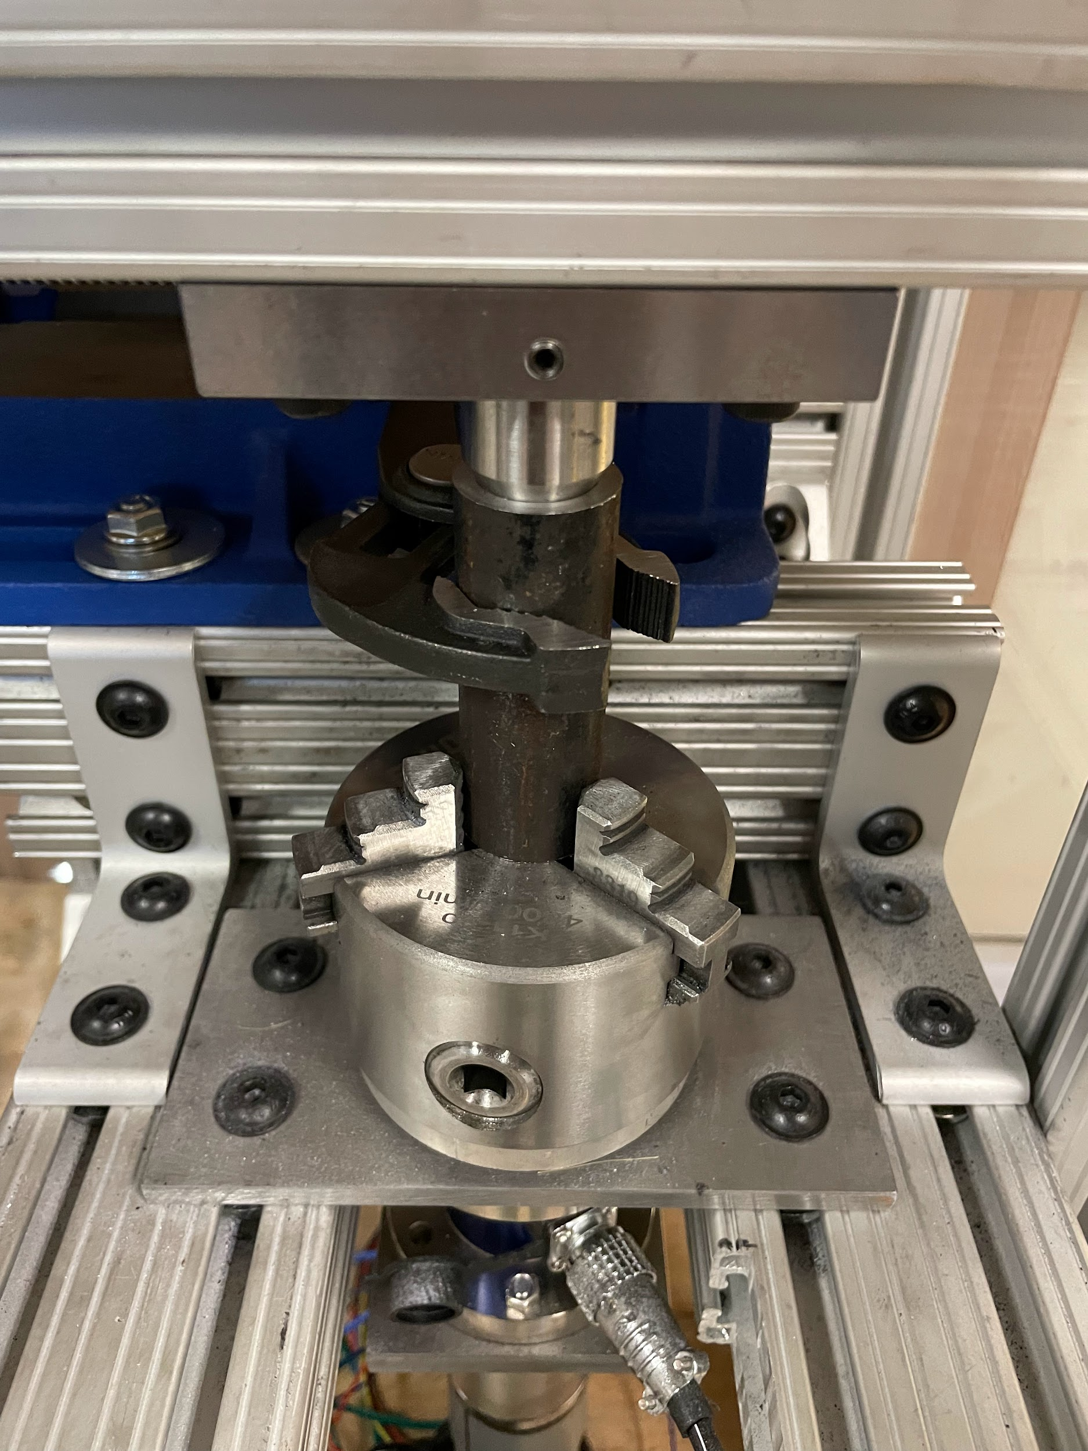
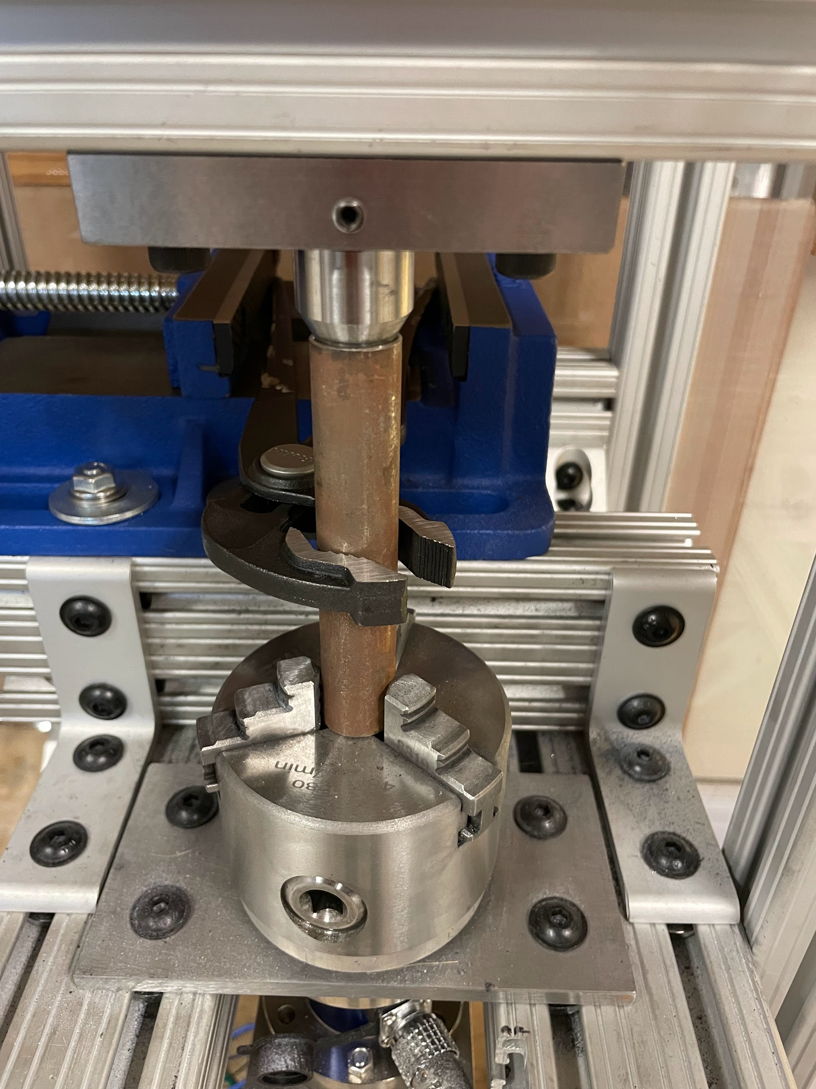
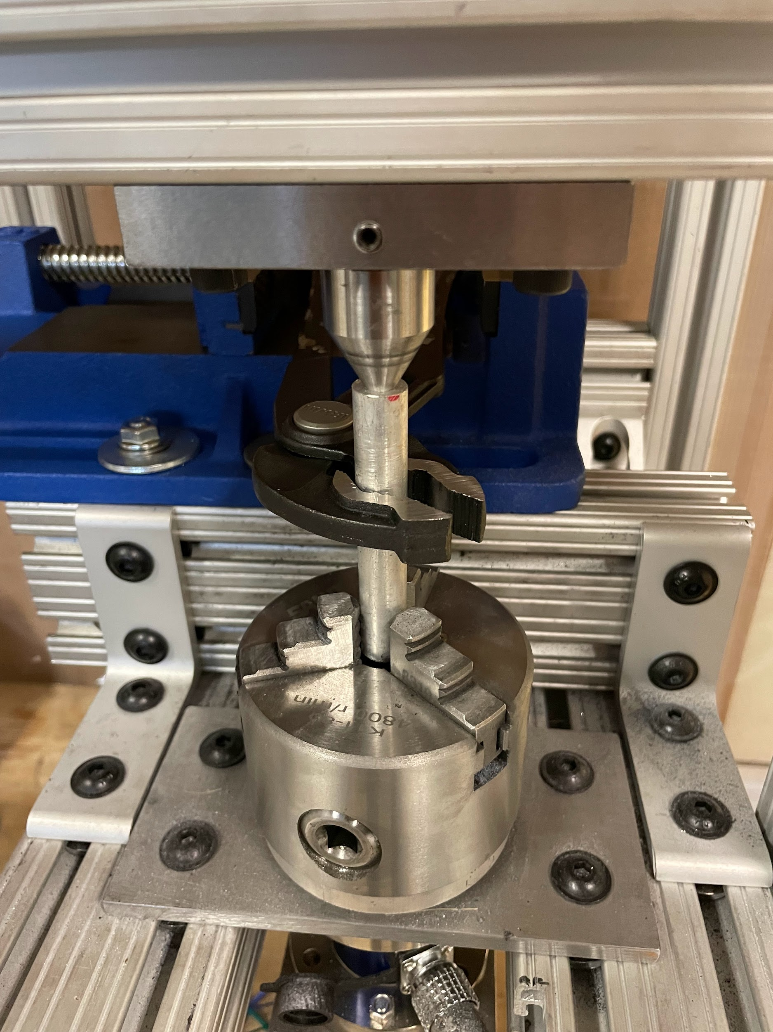
Variable Test Diameter [Tessa]
Torque Cell Calibration
Consistent Wear Test
Plier Universality
Variable Test Piece Diameter
Safety Test
Durability Test
Temp of Test Piece
Environment Temp Test
Usability Test
Notes:
0.5”-1.5”

Slide 12
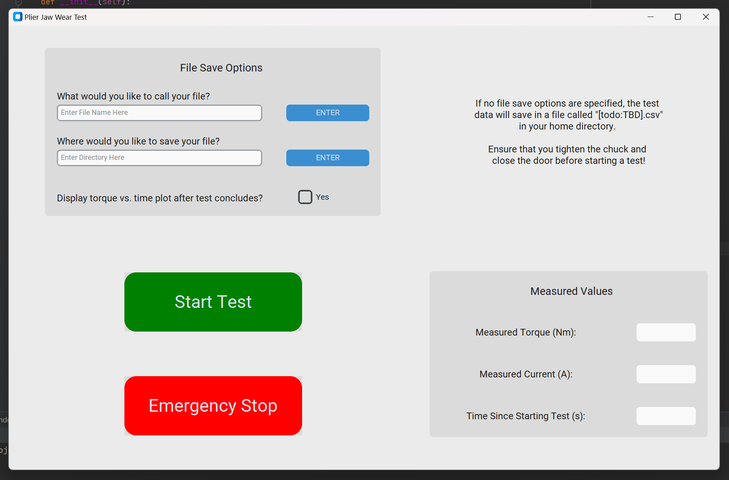
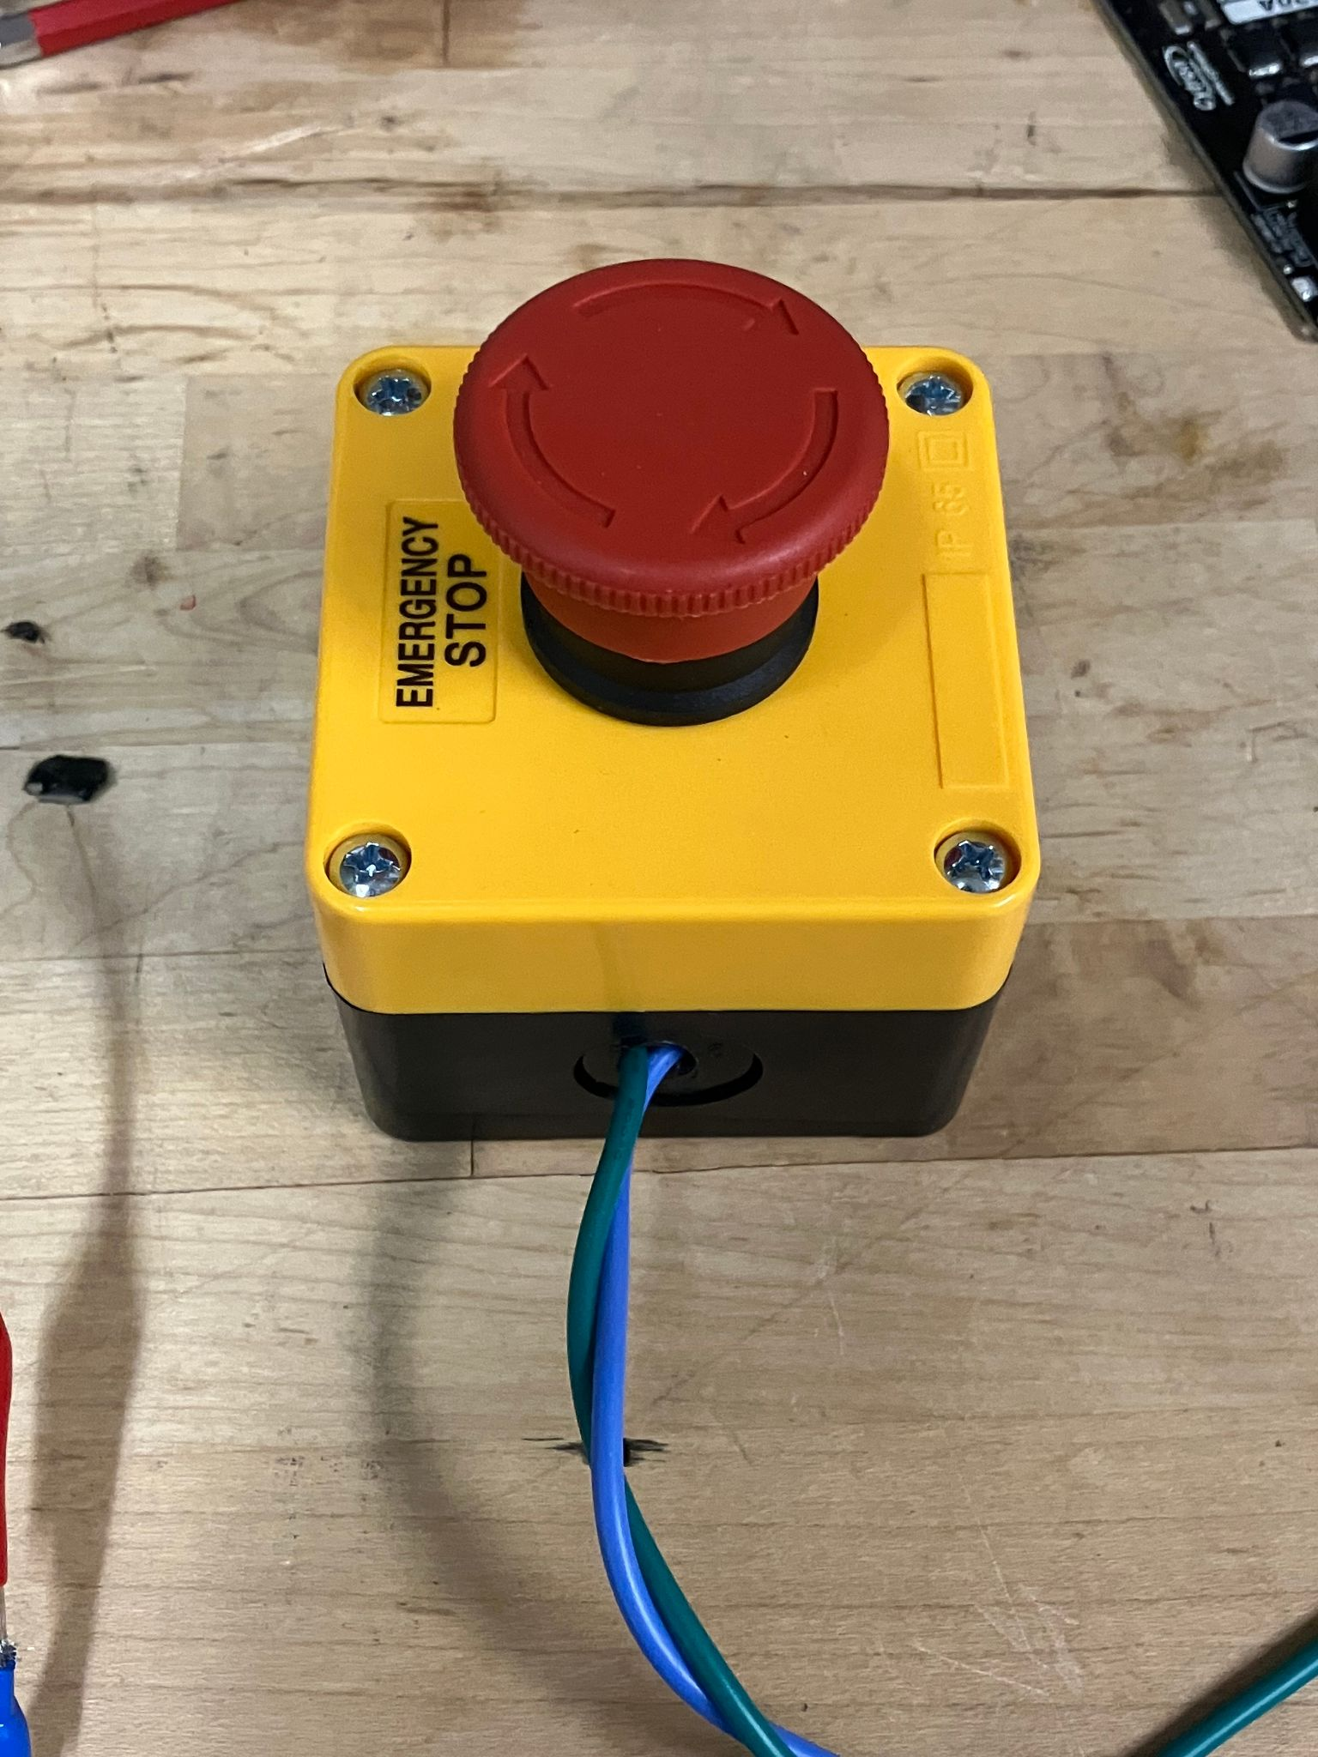
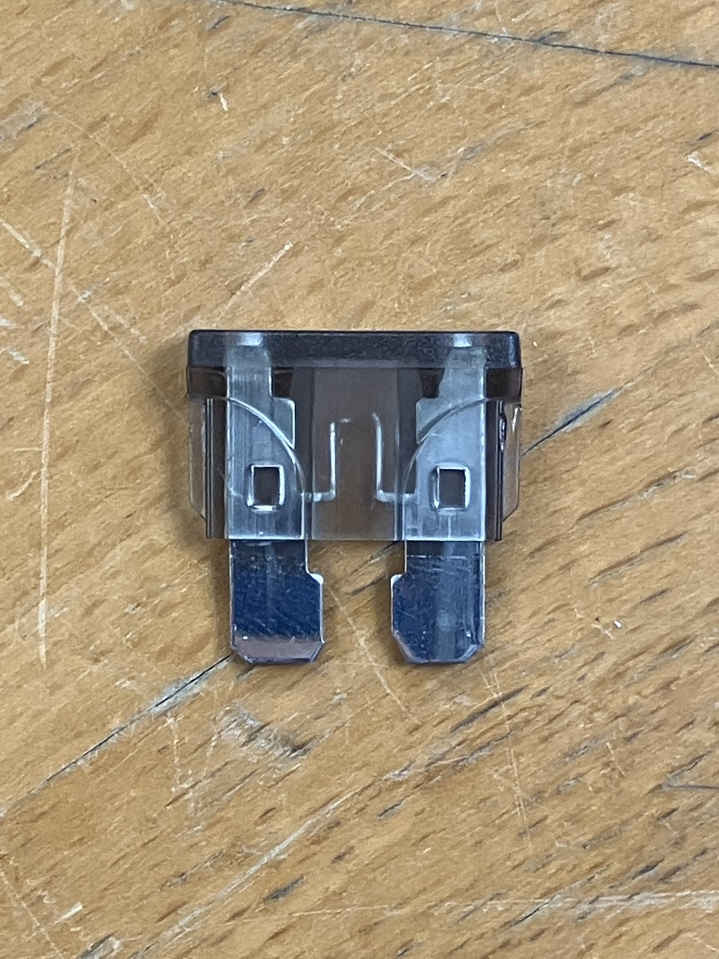
Safety Test [Sasha]
Torque Cell Calibration
Consistent Wear Test
Plier Universality
Variable Test Piece Diam
Safety Test
Durability Test
Temp of Test Piece
Environment Temp Test
Usability Test
Notes:
E-stop kills motor
Pictures of emergency stops

Slide 13
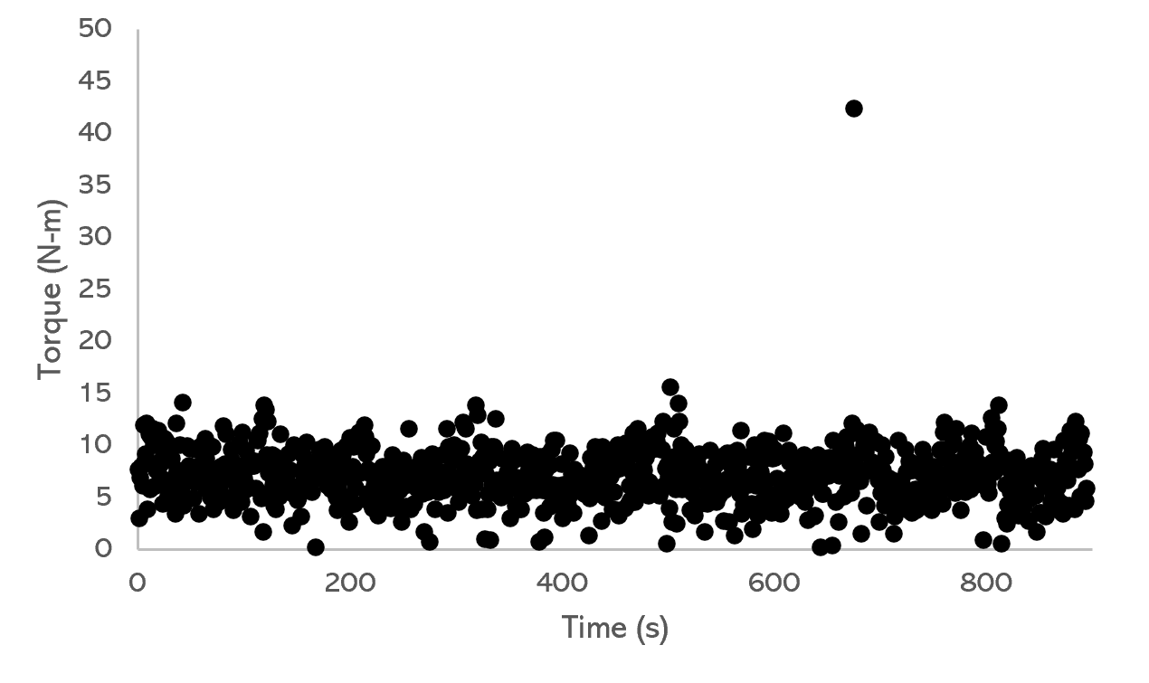
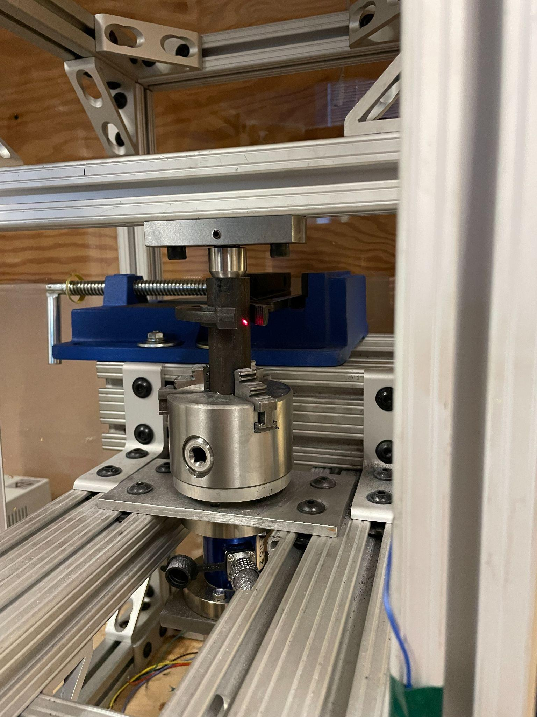
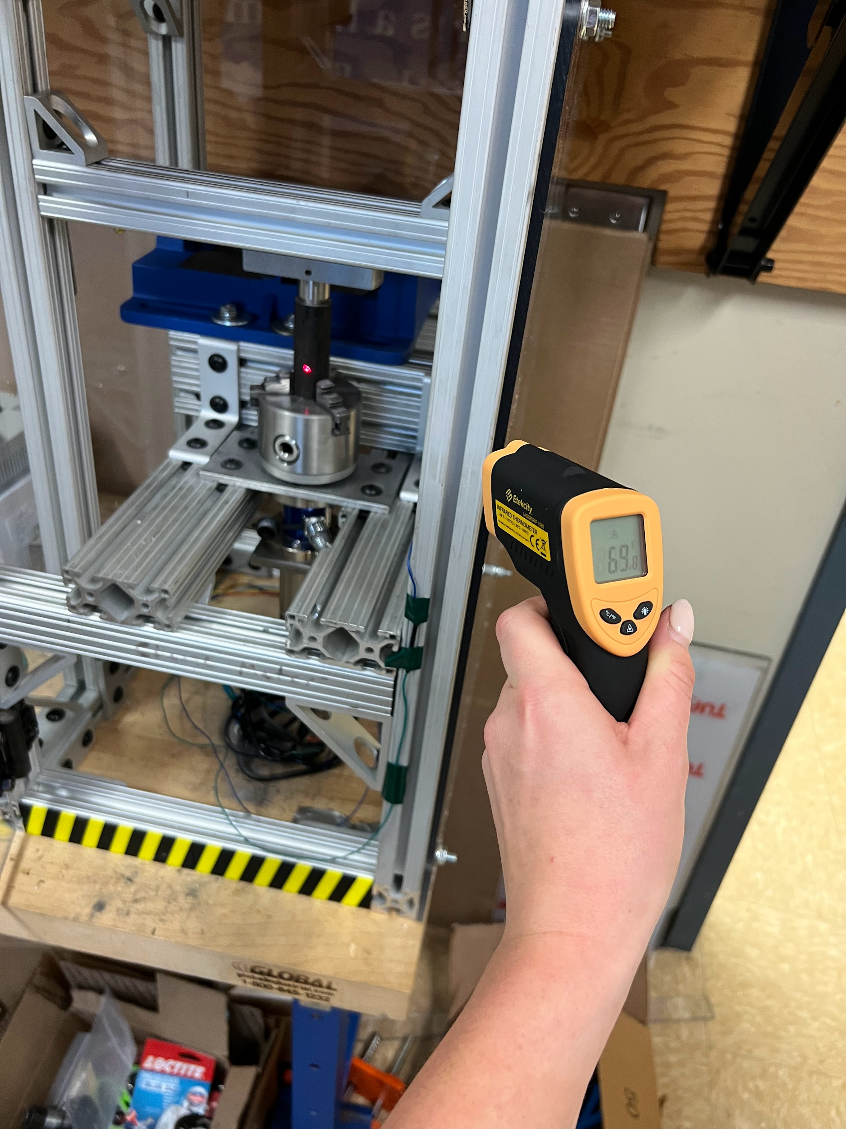
Durability Test [Katharine]
Torque Cell Calibration
Consistent Wear Test
Plier Universality
Variable Test Piece Diam
Safety Test
Durability Test
Temperature of Test Piece
Environment Temperature Test
Usability Test
Notes:
Durability Test: 15 mins → > 5x standard test length
No difference in motor performance/overheating stopping and starting the test for several (4+) hours

Slide 14
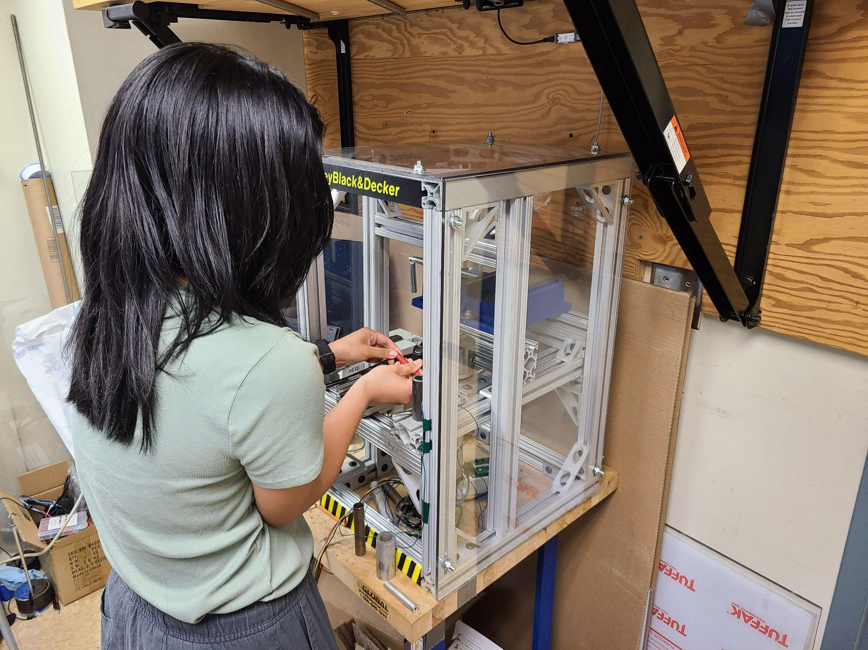
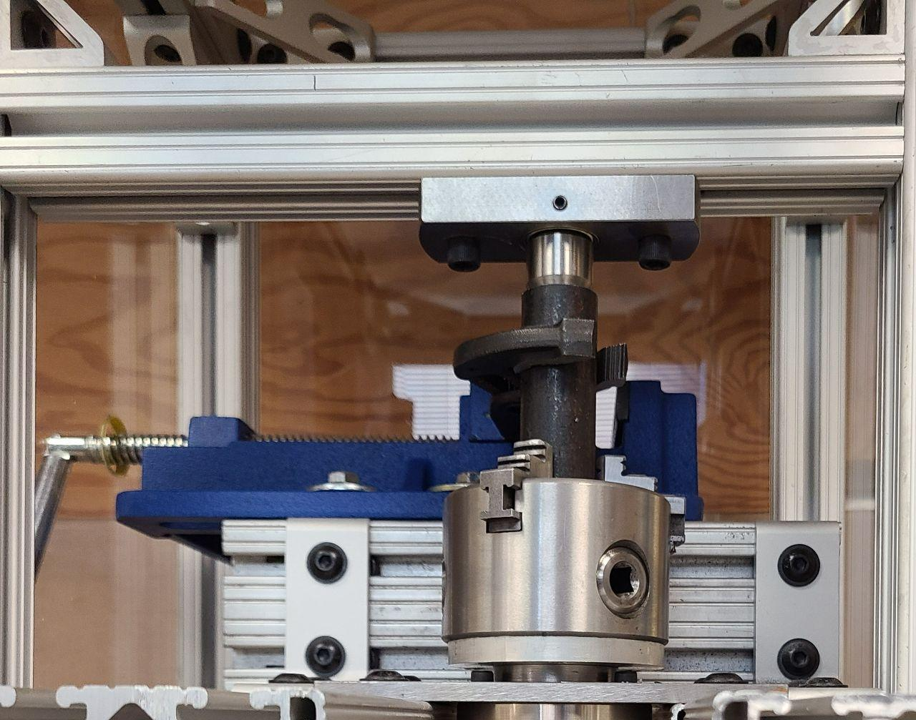
Usability Test [Kelsey]
Torque Cell Calibration
Consistent Wear Test
Plier Universality
Variable Test Piece Diam
Safety Test
Durability Test
Temp of Test Piece
Environment Temp Test
Usability Test
Notes:
TA and fellow senior design students

Slide 15
User Feedback [Kelsey]
Resolved
Path Forward
Suggested Resolutions
1
Loose Parts
Tools Labeled in Drawers
Electronics Soldered
2
Chuck Key
Shorten Handles
Lengthen Chuck Key
3
Limited Space
Additional Door
Replace Allen Wrenches
4
Length of Process
Spring/Hand Crank on Live Center
User Manual
5
Clarity of Instructions
Label Screws
Video Tutorial
Notes:
Things we already fixed:
Chuck key tightening → larger chuck with easier-to-use tightening method
Organized loose tools (chuck key, brushes, Allen wrenches)
Soldering electronics & mounting → takes care
Good feedback - spring on chuck is nice to avoid leaving it in
Chuck key does not have full range of motion - cut down handles
Lengthen chuck key - ratcheting screwdriver
Limited space - make another side into a door
Thumb screws/wing nut instead of allen wrenches because of limited space
Length of swapping test piece and pliers
Live center on springs/crank
Label which screws need to be loosened/which should be left alone
Video tutorial

Slide 16
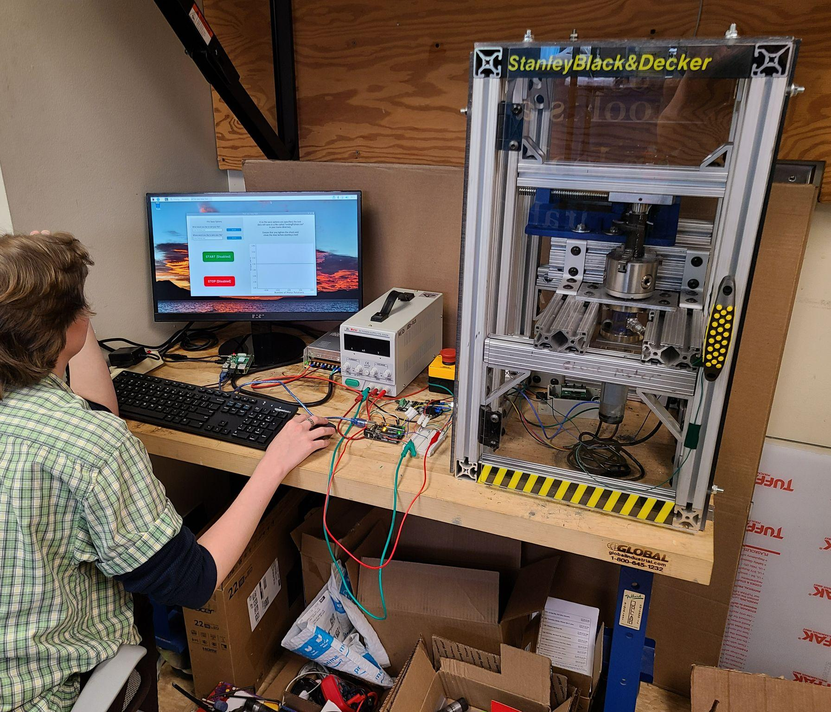
Official Testing [Sasha]
4/03
Official Testing Began
Planned 4 Weeks for Official Testing and Debugging
4/10
Torque Measurement System Broke
Torque Cell Amplifier Broke Due To Manufacturing Error
4/10-4/24
System Repair
Efforts to Repair System and Explore Alternate Options
4/24
Issue Resolved
One Week Remaining for Official Testing and Debugging
Notes:
State set behind but less negative
Torque system broke
Had three weeks for official testing but torque measurement system broke → spent two weeks trying to repair it and trying alternate options → finally got system working but were left with only one week for official testing and making improvements

Slide 17
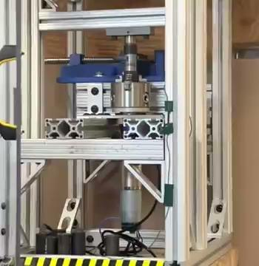
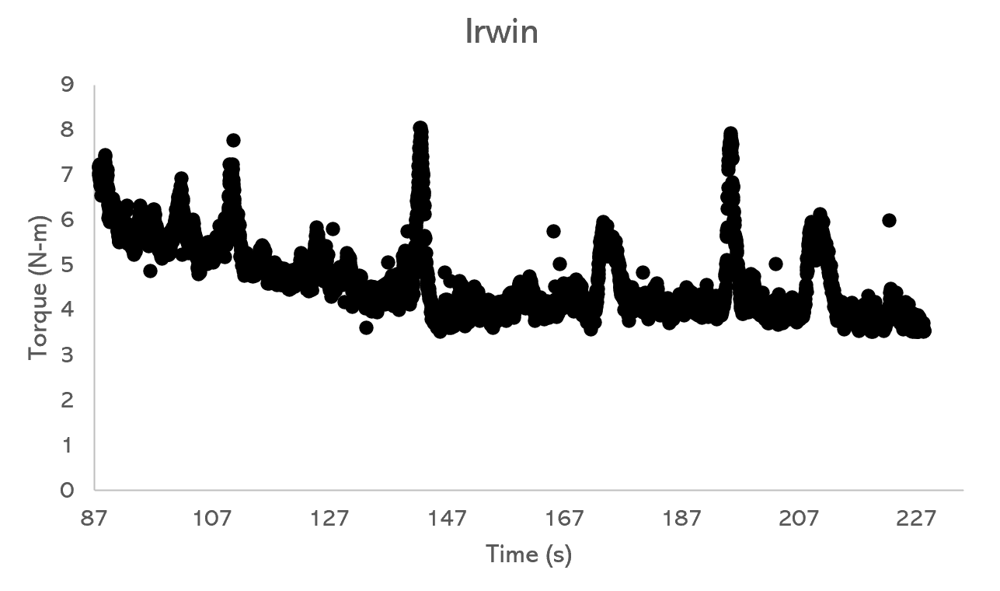
Data & Results: Steel Pipe [Tessa]
Pliers
Data
Path Forward
Notes:
Pliers
Sudden jumps in torque, torque rise back up
Self locking pliers- pliers flipped to fix it
Pin point of slip jaw adjusts which groove
Data
Noisy
Chuck adapter rubbing
Plier teeth adjusting and then changing where they sat on the jaw
Going forward
Some issues could be resolved with large structural changes to the system
Testing one jaw at a time- time of taking apart
Without making a lot of structural changes to our device, we would not be able to get consistent or repeatable torque vs. time data with the steel pipe test piece
Talk about data we got & belkoff’s guesses
Noisy, sudden jumps in torque, torque rise back up
Self-locking mechanism on pliers (hard to predict, flipped pliers around)
Pin point of plier handles/jaws slips, causing sudden jumps
Could get around this by only testing one jaw at a time, but would require a lot of time taking pliers apart and making structural changes to device

Slide 18
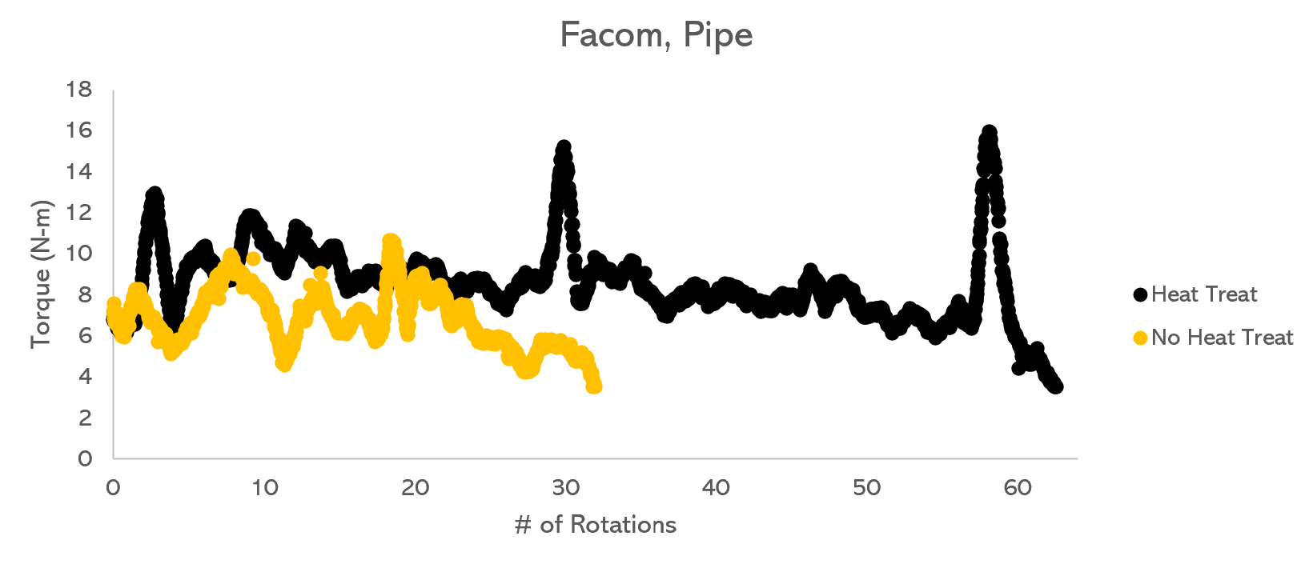
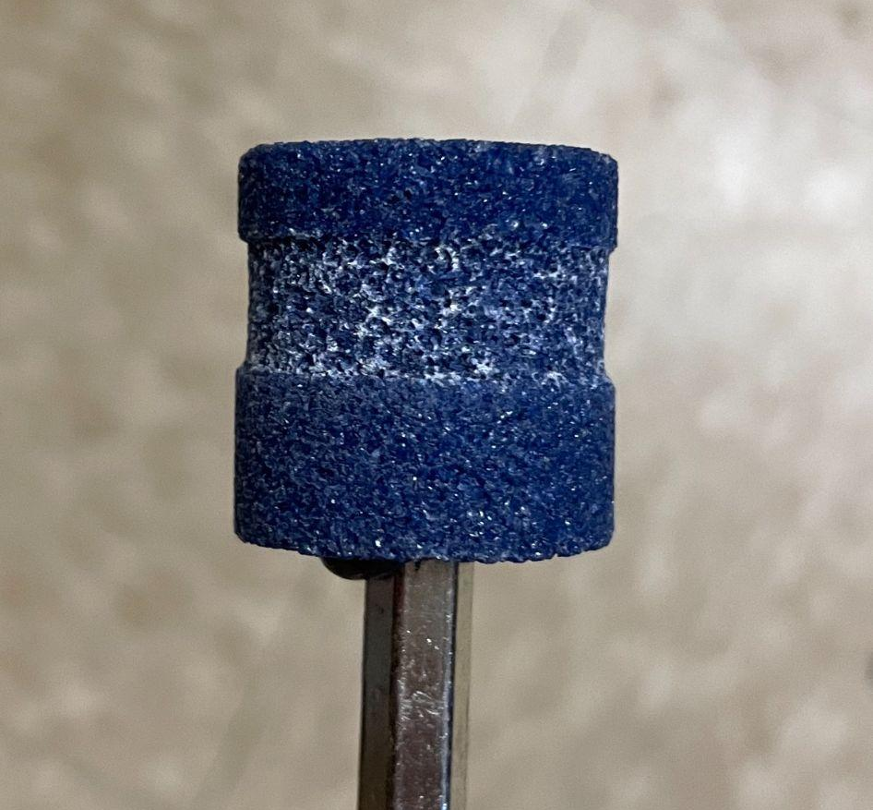
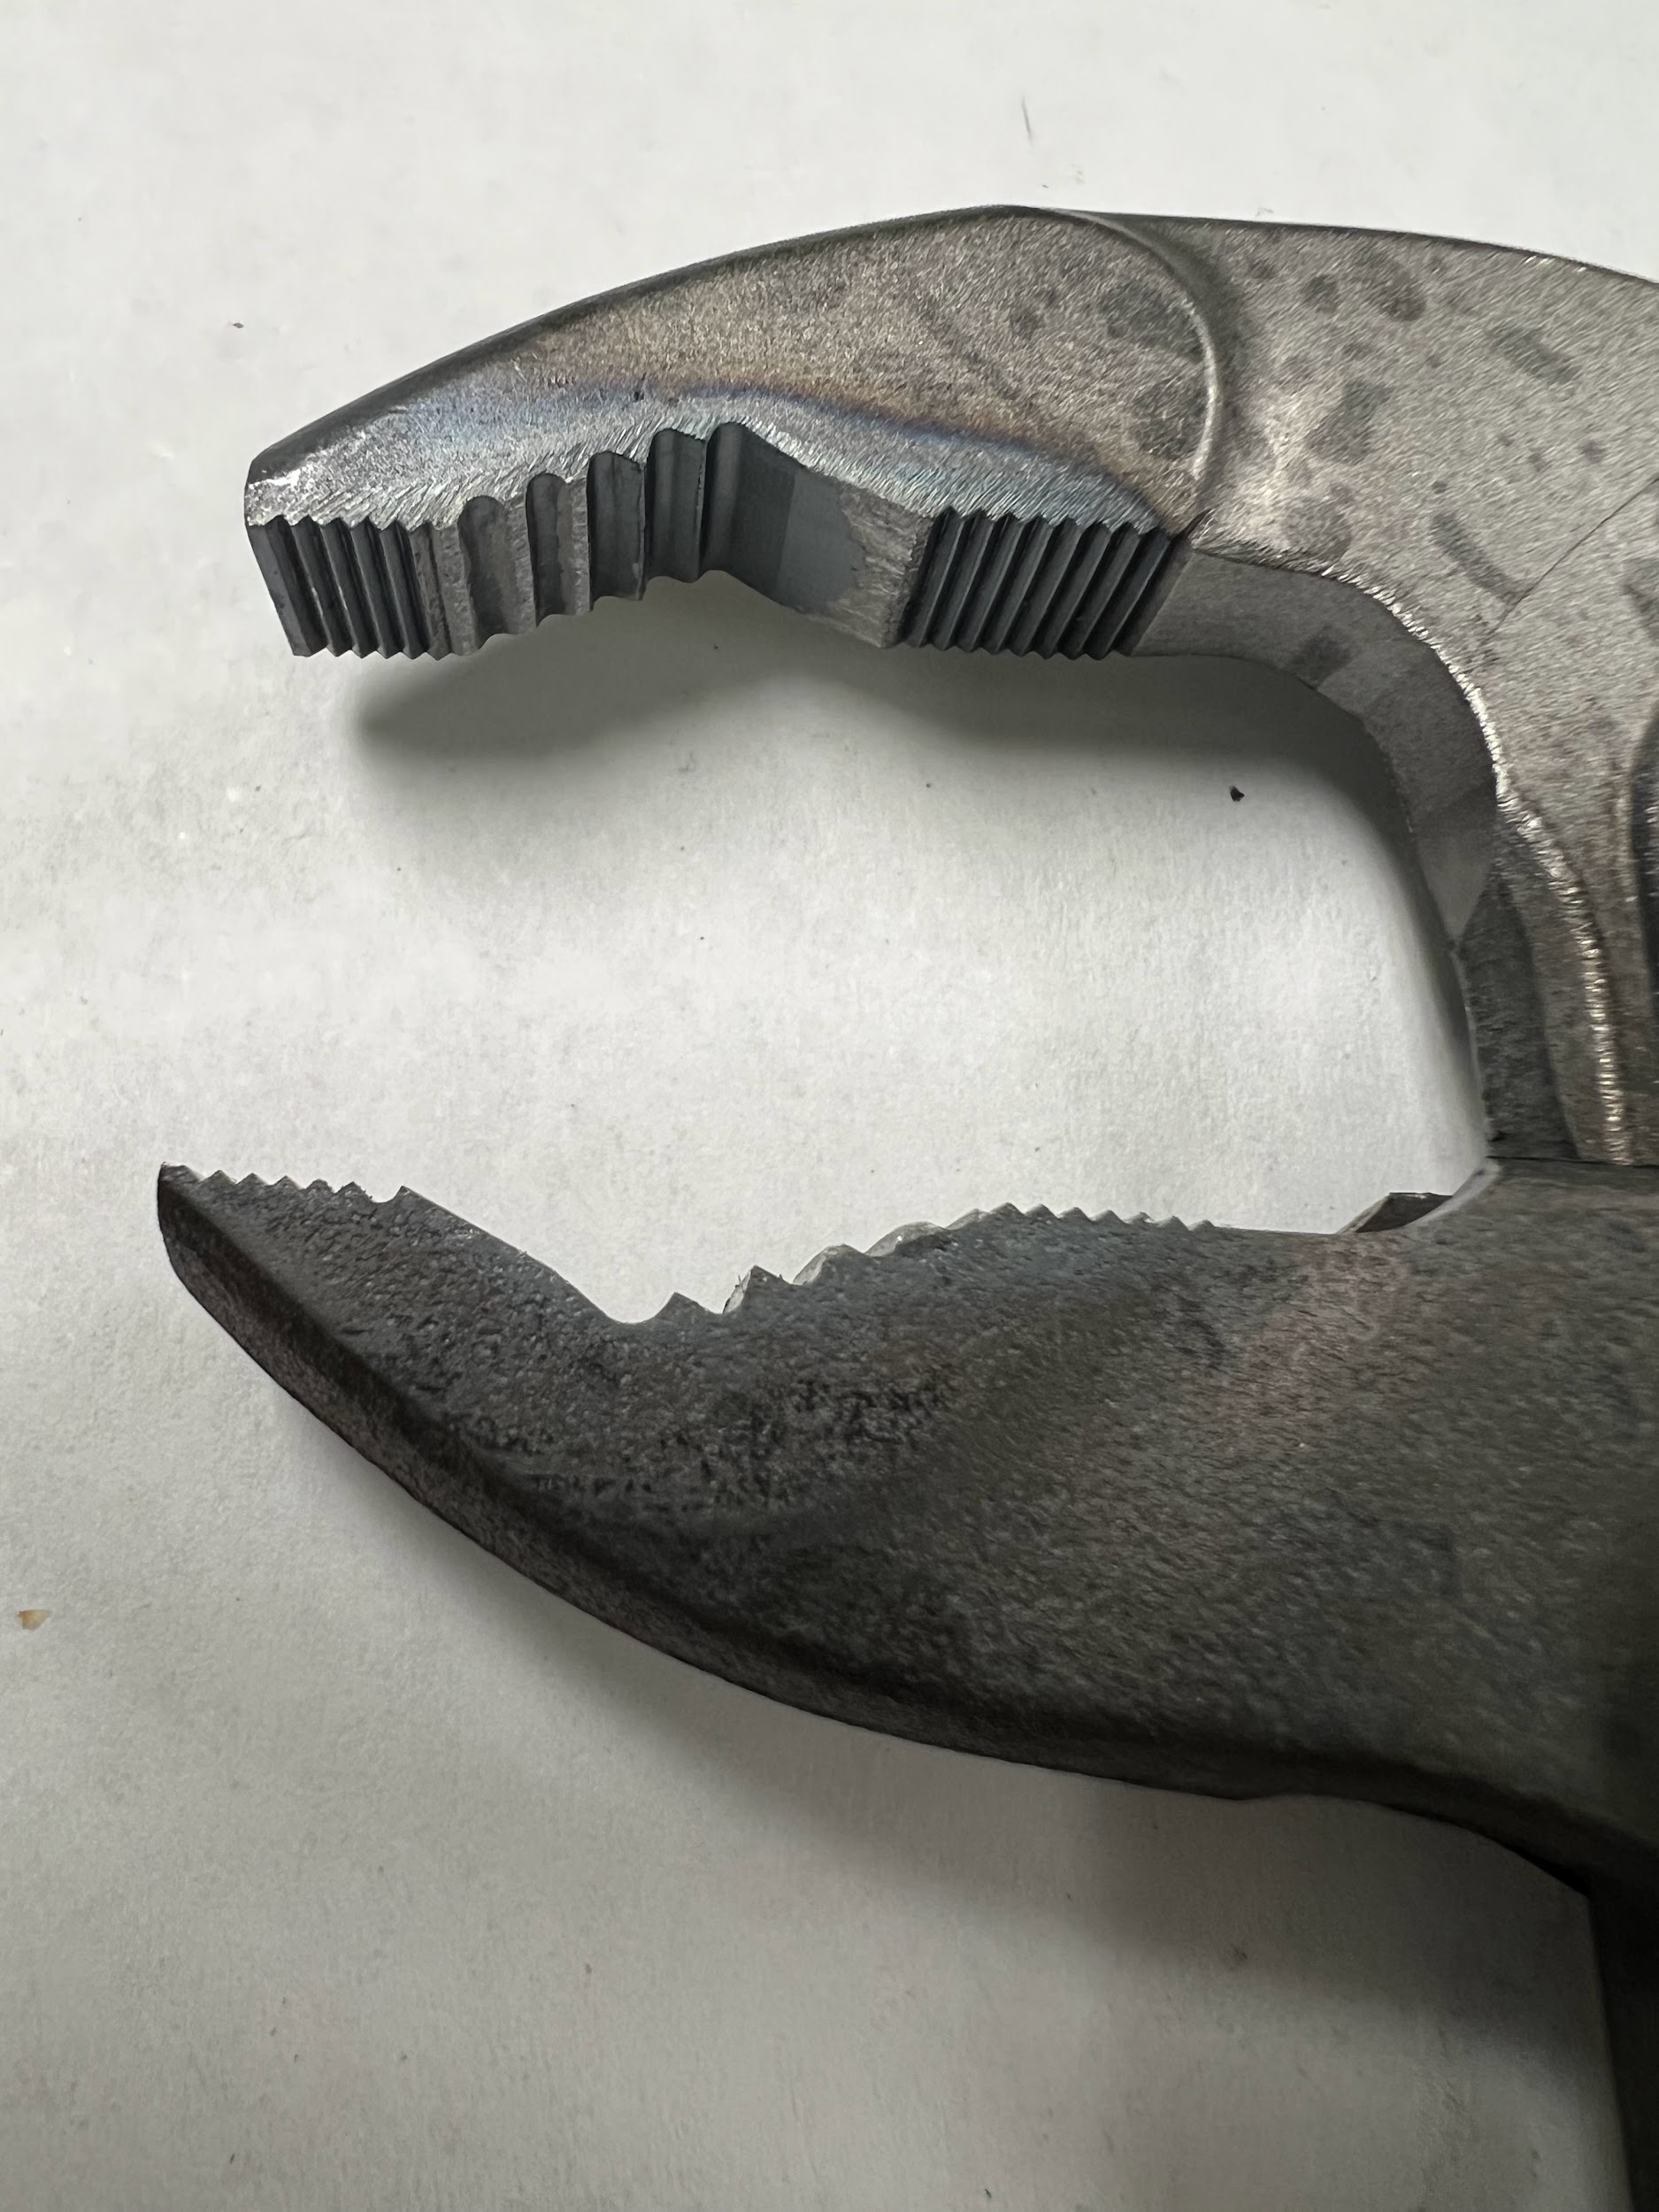
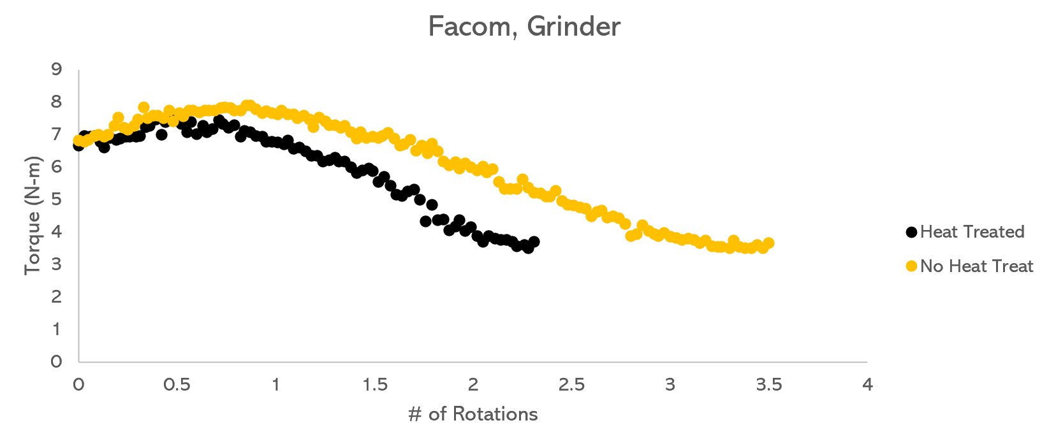
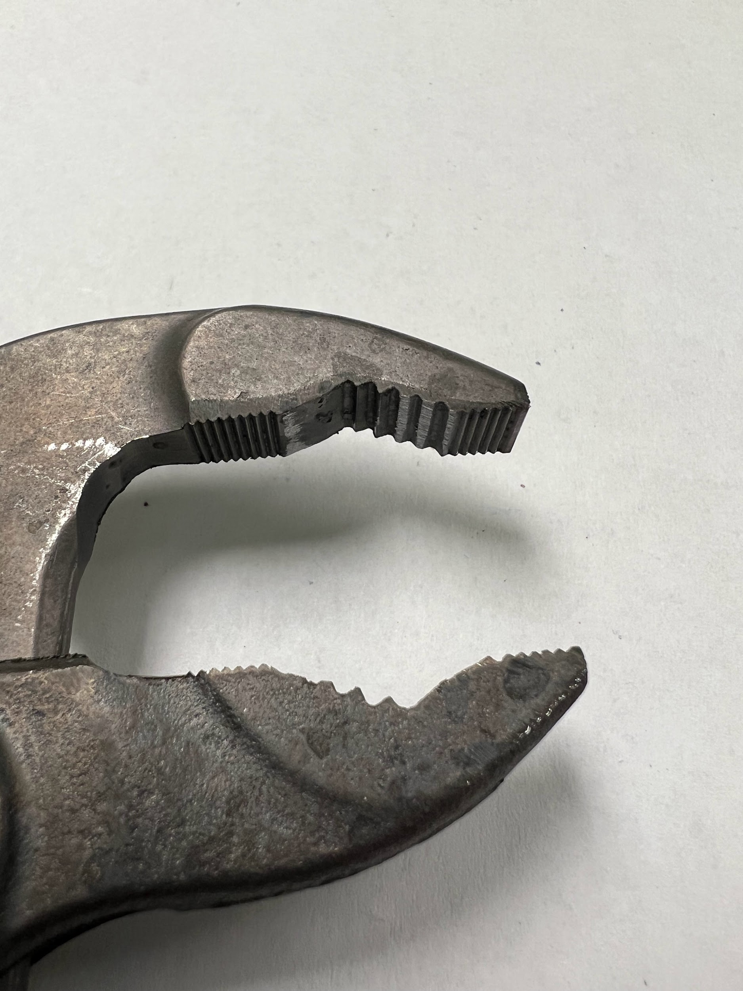
Data & Results: Grinder Bits [Katharine]
Notes:
Consistent colors
Altering test protocols
Torque may not be outcome measurement
We originally decided against grinder bits because they would significantly wear down before we even got to the start torque (so hard to repeat tests exactly)
But since our test piece data was so inconsistent, we went back to grinder bits since they produced much more consistent wear and eliminated noise in the data

Slide 19
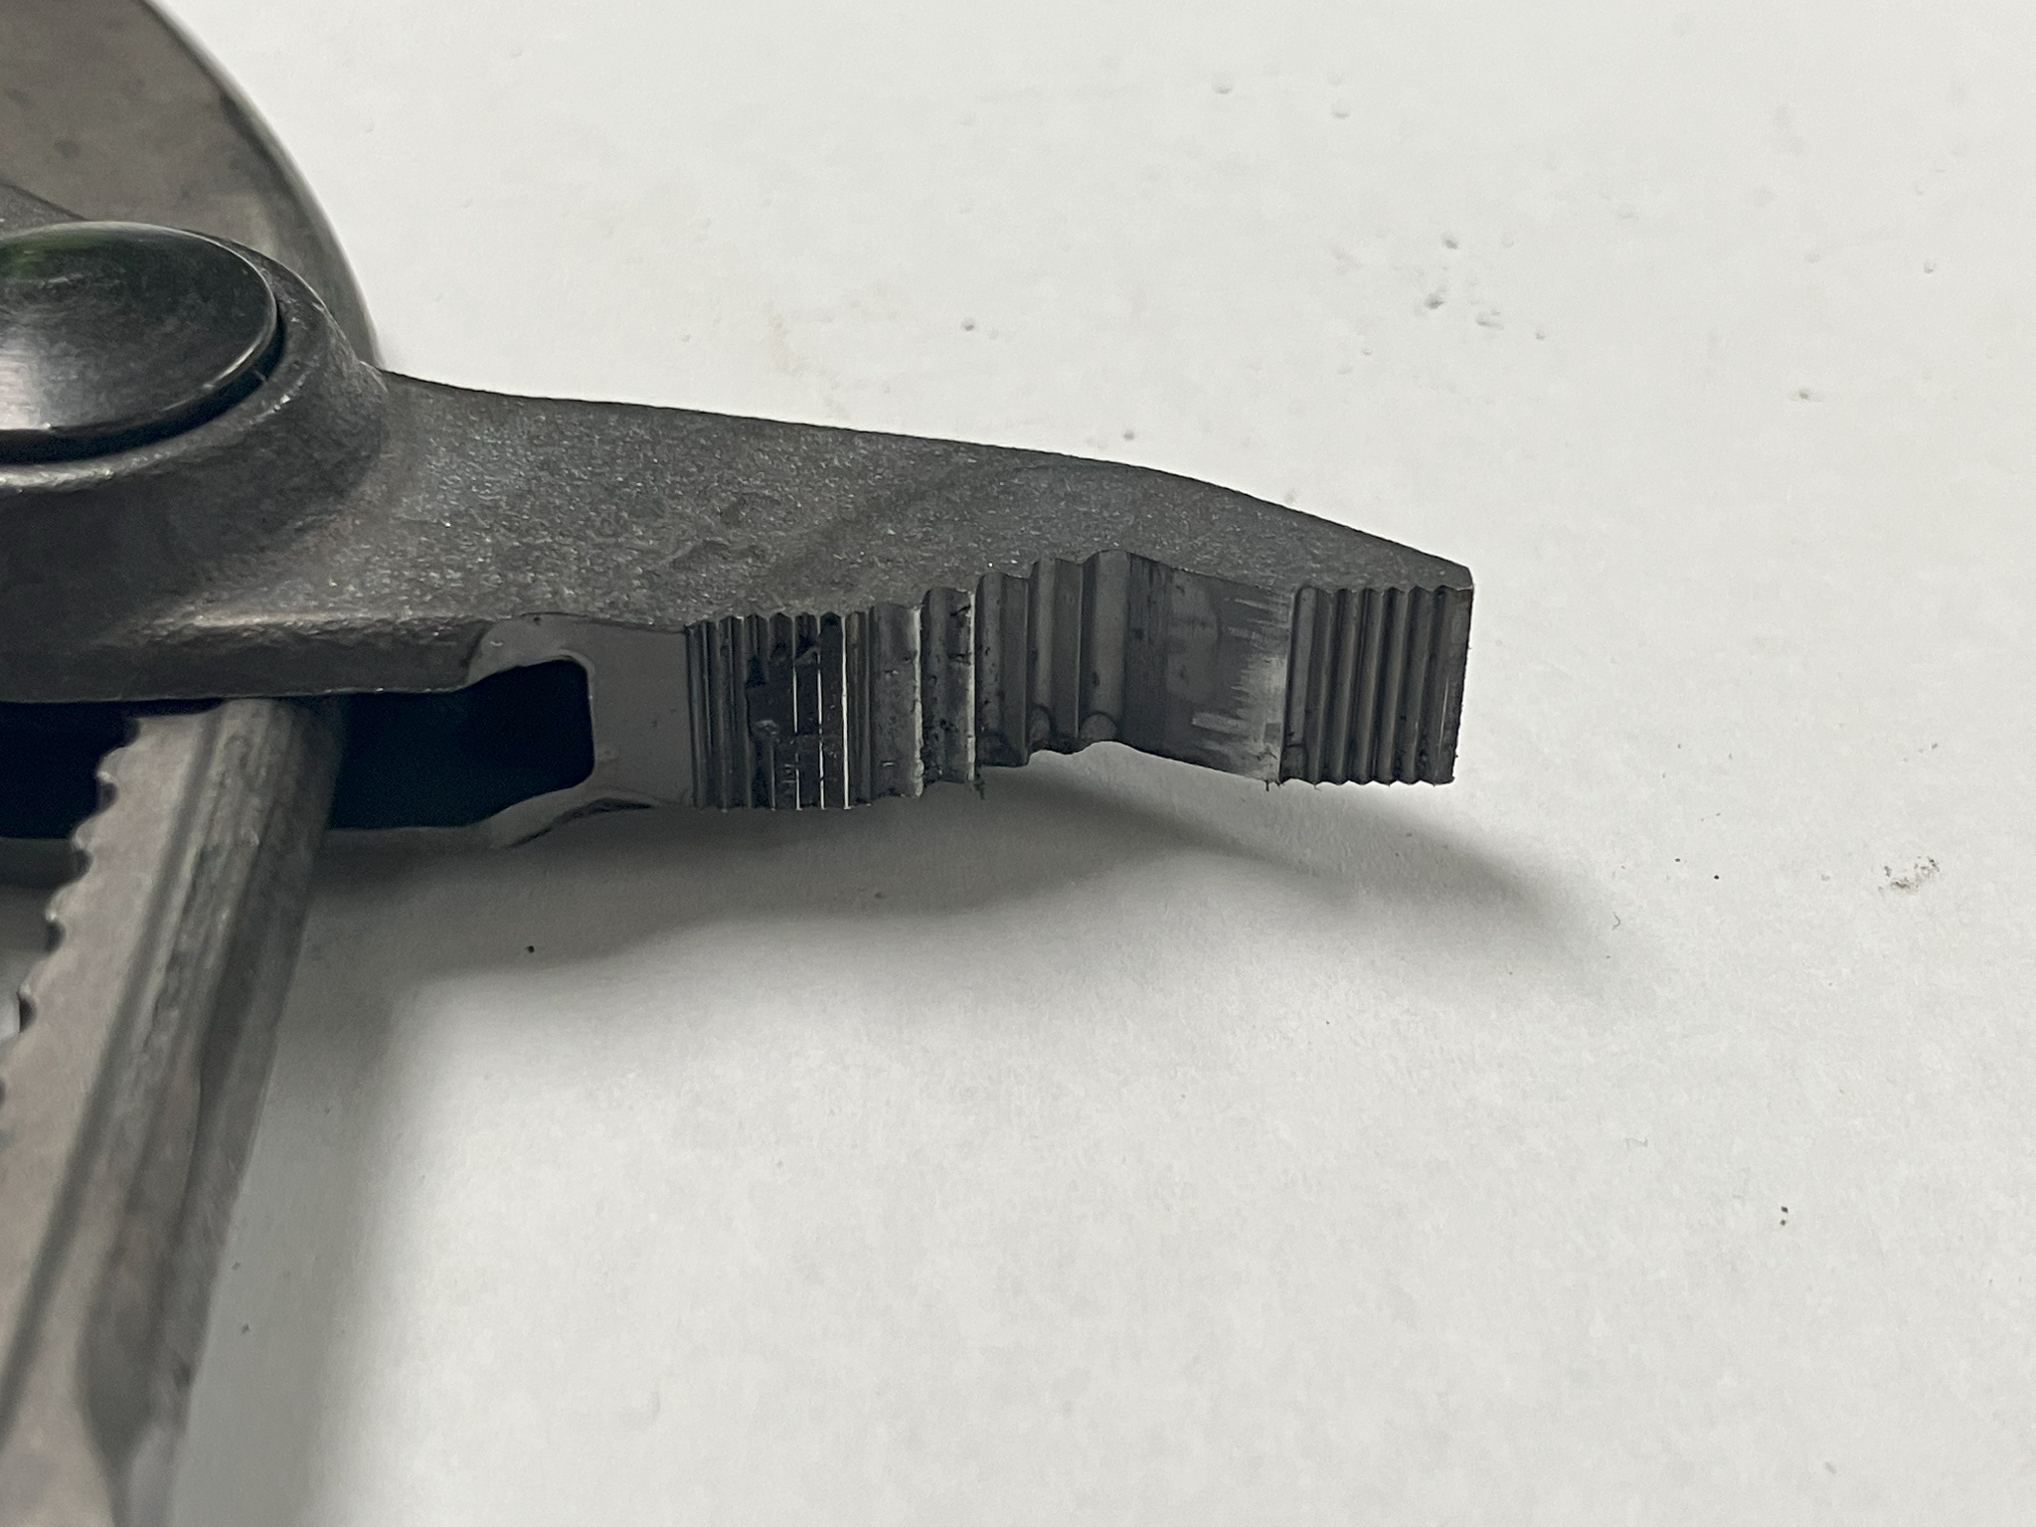
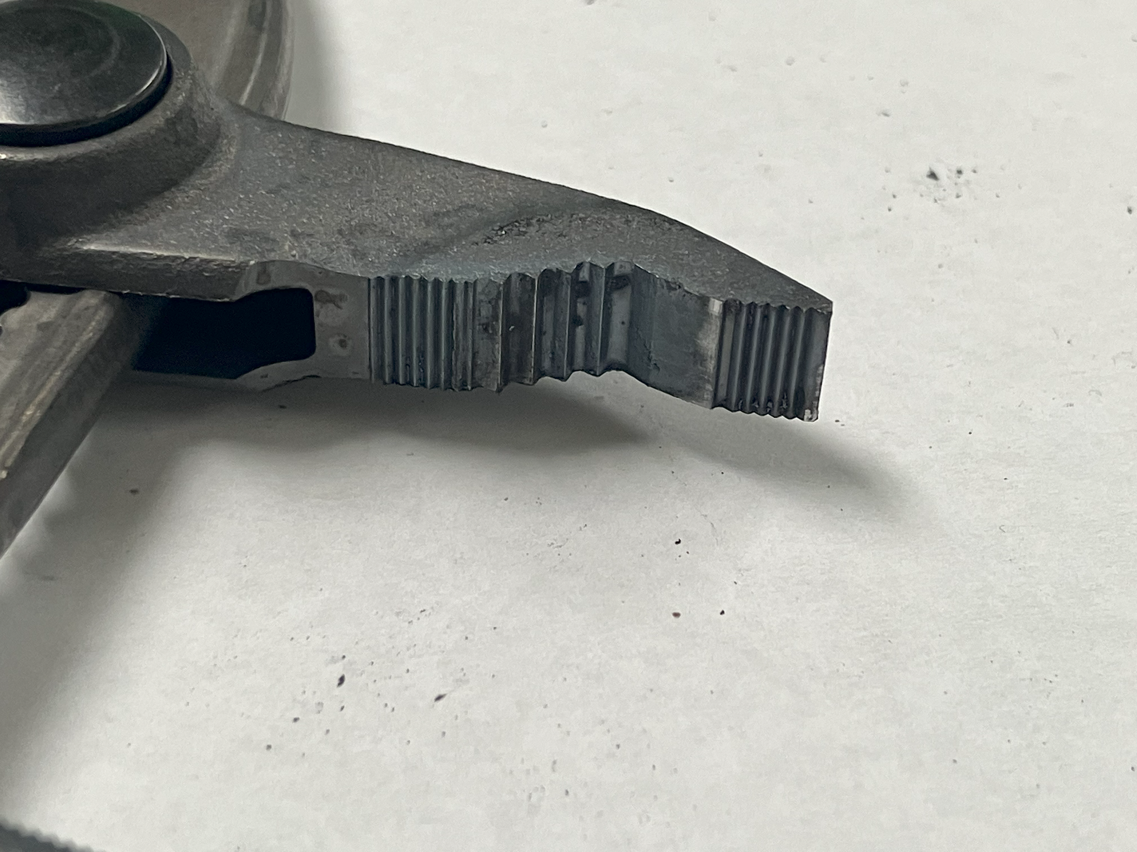


Conclusions [Katharine]
Heat Treatment
Geometry
No Secondary Heat Treatment
Secondary Heat Treatment
V-Jaw
Straight Jaw
Notes:
Self locking
Plier mounting - conform to handles to avoid wobbling
Noisy data - due to plier teeth
Test pieces - metal pipe vs grinder bits (looks nicer but not repeatable - gets rid of self - locking/wears down too fast)
Test pieces conclusions:
V jaw not comparable to straight jaw
V jaw much more wear resistant than straight jaw
Heat Treated vs No secondary heat treatment
Visually, small amount of increased wear on teeth when run for same amount of time at same starting torque
To quantify whether any difference is present and if it is statistically significant, need repeatable tests
Straight Jaw vs V Jaw
Both Channellock
V Jaw has more contact points, straight jaw fails test faster because only one/two teeth in contact with test piece

Slide 20

Looking Forward [Kelsey]
Repeatability
Electronics
User Feedback
Notes:
Statistical Analysis
Testing One Jaw
Vice Conform to Plier Handle
Improve Updating Speed of GUI Graph
Automate Tightening Vice/Live Center
Length/Ease of Process
Looking forward, the path to get comparable data is to
Yensabro suggested this slide–we could def use it
Increase repeatability of testing in order to run actual statistic testing
One jaw testing?
Better plier handle gripping system?
Improvements from user feedback
Automate live center and vice tightening
(if not fixed) speed of GUI graph updating
Time to unscrew and tighten everything down

Slide 21

Finance [Sasha]
Start: $9,500
Used: $7,300
Budget Remaining: $2,200

Slide 22

Summary [Katharine]

Slide 23


Acknowledgements [Katharine]
Notes:
Chris and Josh at SBD
Professor Belkoff and TAs (Yens)
Mark and everyone at the professional machine shop

Slide 24
Thank You!
Any Questions?

Slide 25
References
Slide 29:
https://www.stanleyblackanddecker.com/themes/custom/stanley_default/logo.svg
https://www.google.com/url?sa=i&url=https%3A%2F%2Fwww.facebook.com%2FJHUMESD%2F&psig=AOvVaw0m8x8aCjNLflF_-icgRxkV&ust=1682911372407000&source=images&cd=vfe&ved=0CBAQjRxqFwoTCKDYr8bT0P4CFQAAAAAdAAAAABAD

Slide 26
Appendix

Slide 27


Vice
Notes:
Why we chose this vice
add pictures of other aluminum vice

Slide 28
Reflection on Requirements
Requirements | Percentage Achieved
Safe | 100%
Measurable wear, collects data on: Torque # of Rotations | 100%
Consistent wear that allows for comparison and evaluation of data | 30%
Universal for different plier sizes and types | 70%
Easily exchangeable pliers | 80%
Universal for different size test pieces up to 1.5 inch | 100%
Easily exchangeable test pieces | 80%
Notes:
Can hold all sizes of pliers- the jaw geometry effects how

Slide 29
User Feedback
Resolved
Path Forward
Suggested Resolutions
1
Loose Parts
Tools Labeled in Drawers
Electronics Soldered
2
Chuck Key
Shorten Handles
Lengthen Chuck Key
3
Limited Space
Additional Door
Replace Allen Wrenches
4
Length of Process
Spring/Hand Crank on Live Center
User Manual
5
Clarity of Instructions
Label Screws
Video Tutorial
Notes:
Things we already fixed:
Chuck key tightening → larger chuck with easier-to-use tightening method
Organized loose tools (chuck key, brushes, Allen wrenches)
Soldering electronics & mounting → takes care
Good feedback - spring on chuck is nice to avoid leaving it in
Chuck key does not have full range of motion - cut down handles
Lengthen chuck key - ratcheting screwdriver
Limited space - make another side into a door
Thumb screws/wing nut instead of allen wrenches because of limited space
Length of swapping test piece and pliers
Live center on springs/crank
Label which screws need to be loosened/which should be left alone
Video tutorial

Slide 30

Frame Dimensions

Slide 31

Electronics Wiring Diagram

Slide 32




Data & Results: Grinder Bits [Katharine]
Pipe
Grinder
Notes:
Consistent colors
Altering test protocols
Torque may not be outcome measurement
We originally decided against grinder bits because they would significantly wear down before we even got to the start torque (so hard to repeat tests exactly)
But since our test piece data was so inconsistent, we went back to grinder bits since they produced much more consistent wear and eliminated noise in the data

